Slide 1
Pedestrian Safety Campaign
July 19, 2017

Slide 2
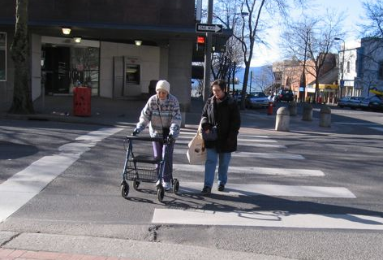
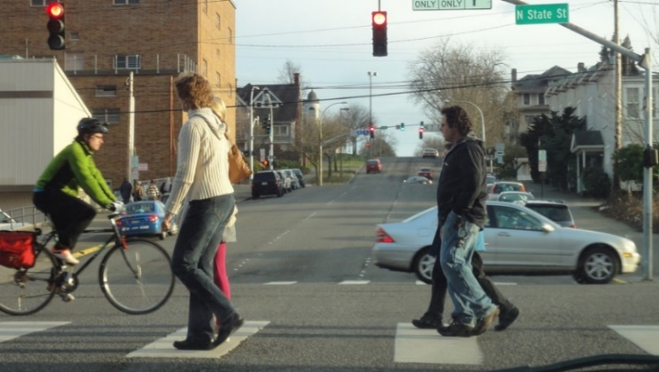
Pedestrian Safety Campaign
Review data
Set goals, objectives
Research best practices
Develop strategies/tactics
Evaluate

Slide 3
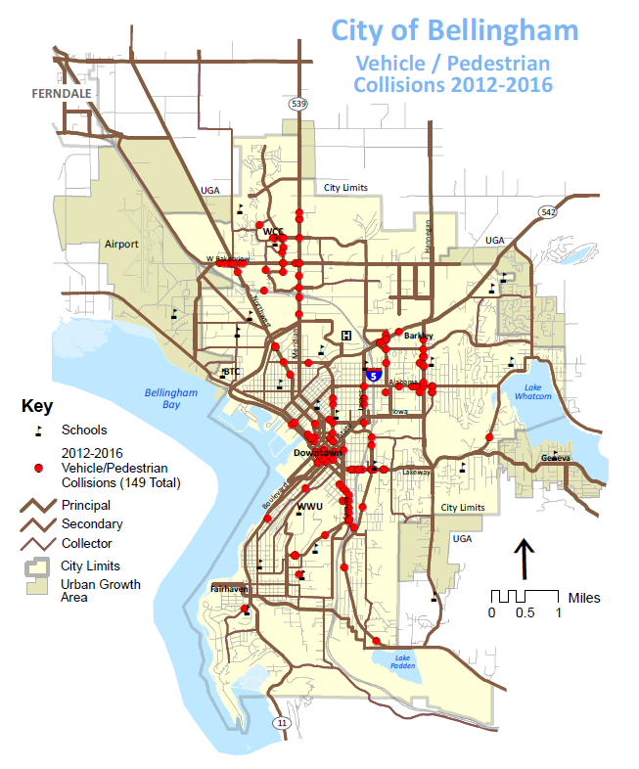

Slide 5
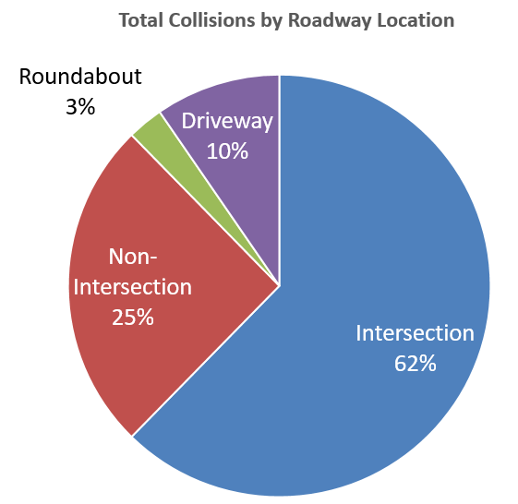
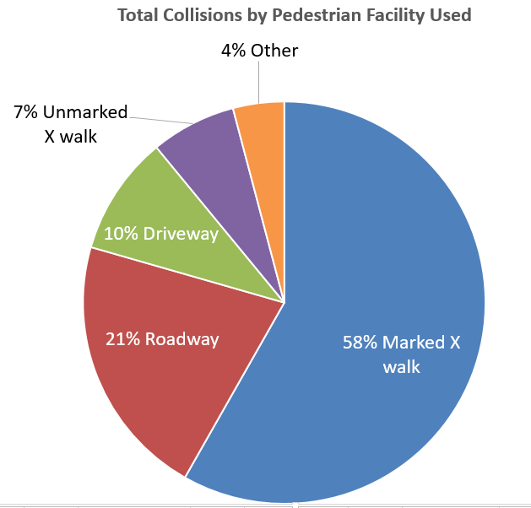
Where are collisions occurring in the roadway?

Slide 6
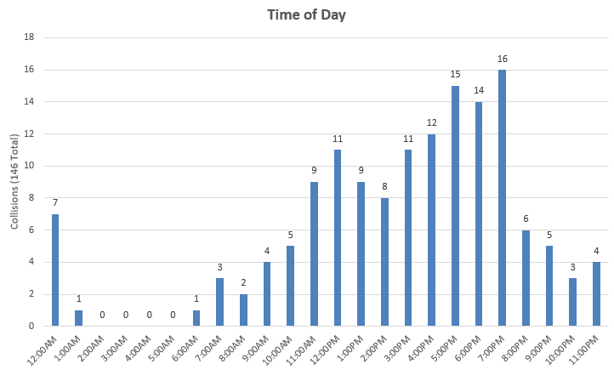
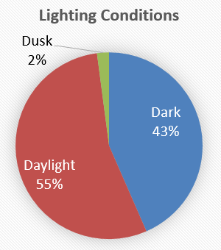
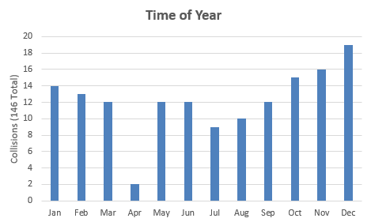

Slide 7
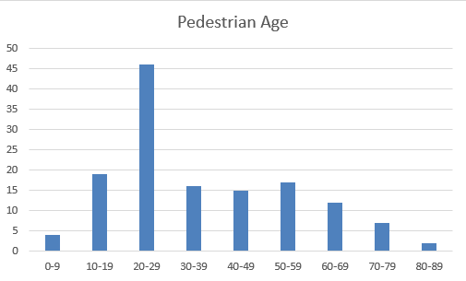
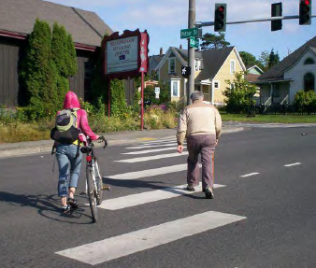
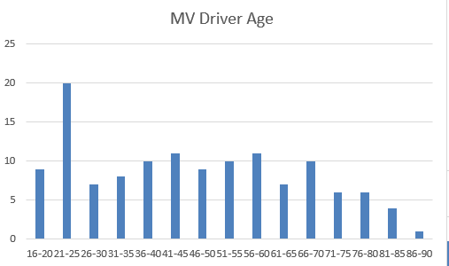
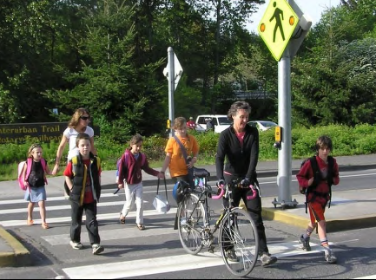

Slide 8
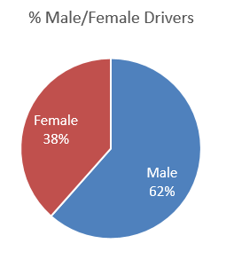
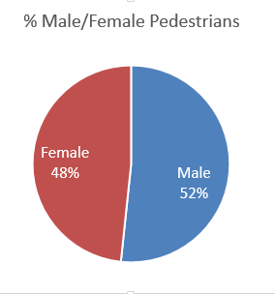

Slide 9
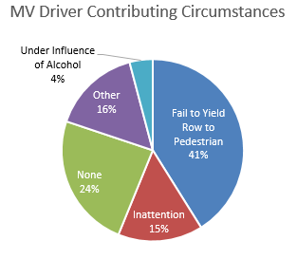
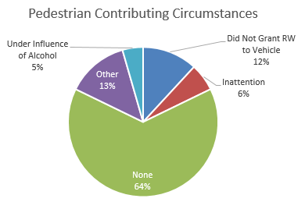
Contributing Circumstances

Slide 10
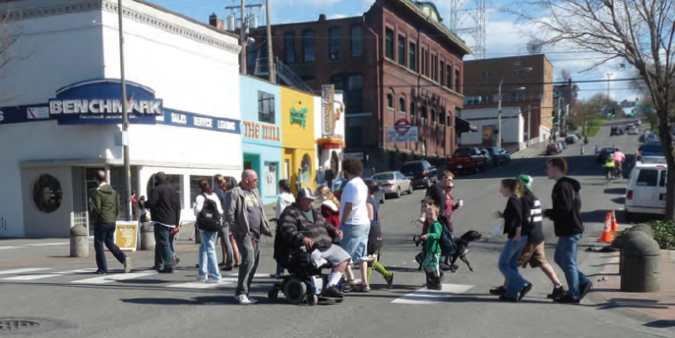
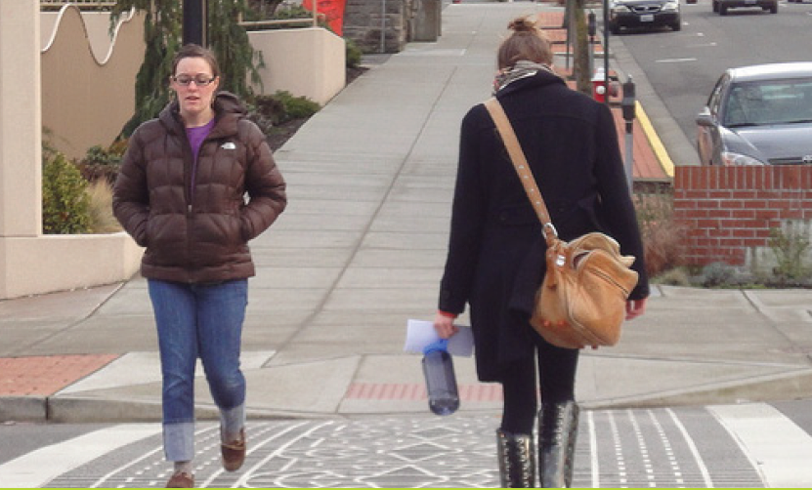
Campaign goal
  Zero pedestrian-motor vehicle collisions.
  Objective: To increase responsible behavior and reduce distractions and other avoidable causes of collisions.

Slide 11
Strategy 1
Foster safe driving and walking behaviors using “social norming” messages
  Tactics:
    “travel with care” messages
      Video PSAs
      Radio ads
      Social media posts
      Transit ads
      Sanitary Service Company truck

Slide 12
Strategy 2
Educate motorists and pedestrians about rules of the road and safe behaviors
  Tactics:
    Ex: every intersection is a legal crossing, whether marked or unmarked
      Radio PSAs
      Social media posts
      Engage with MNAC, community groups
      Information cards

Slide 13
Strategy 3
Enforce rules of the road
  Tactics:
    Advertise upcoming enforcement efforts
    Perform emphasis patrols (crosswalk, speed compliance, distraction)
    Recognize right behavior when observed

Slide 14
Evaluate
Social norming messages, education
  Monitor social media activity, website traffic
Enforcement
  Citations given
Monitor, evaluate collision data
Monitor pedestrian activity
Notes:
Counts, trip generators

Slide 15
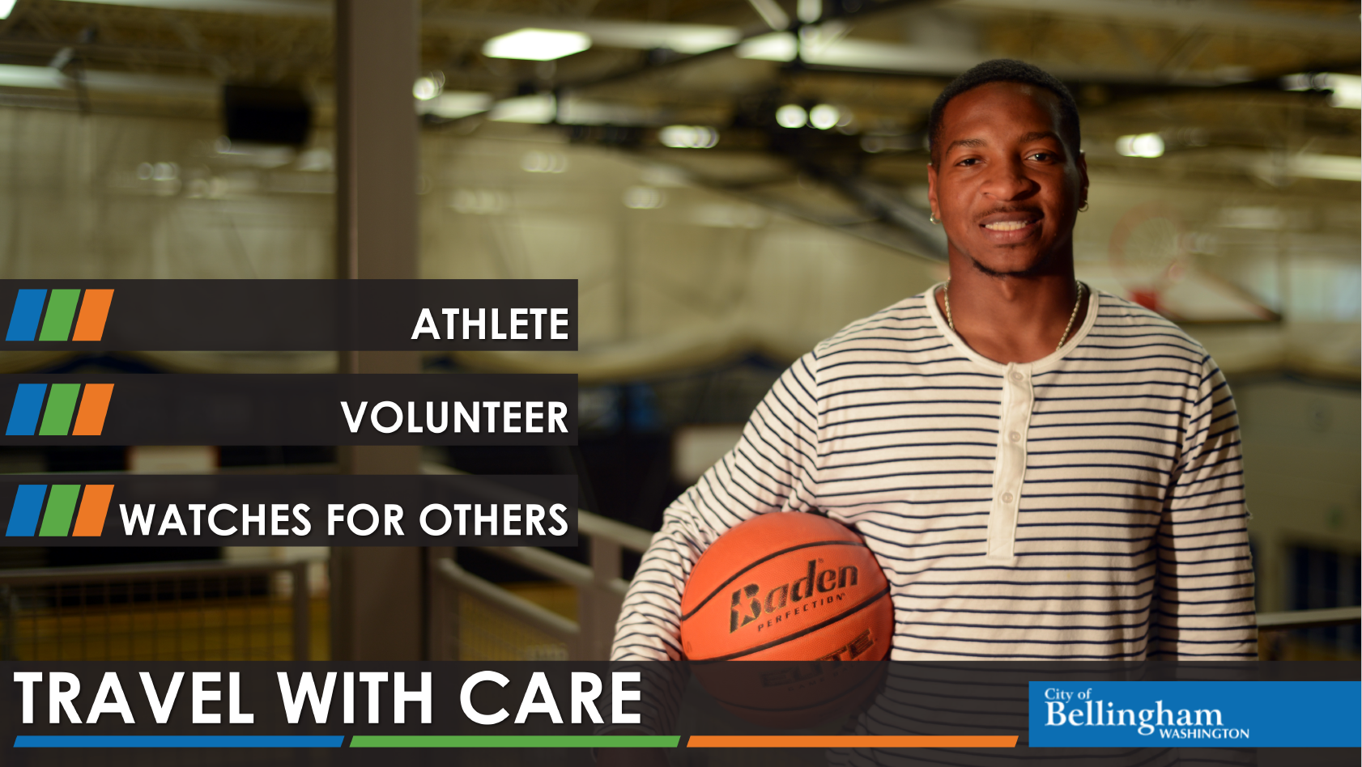
https://youtu.be/5t3UTZdDeWc

Slide 16
Leading the way
Model good behavior
  Driving (speed, yielding, cell phone use)
  Walking (make eye contact, cell phone use when crossing)
  Bicycling (visibility at night, follow rules of the road)
Post campaign messages on neighborhood social media sites
Discuss topic at neighborhood meetings
Engage PTA
  Safe driving behaviors during school drop-off and pick-up
  Post campaign messages for students and parents
Notes:
Counts, trip generators

Slide 17
Questions?
Kim Brown, ADA Coordinator, Public Works
Carr Lanham, Traffic Sergeant, Police
Doug Dahl, Target Zero Manager, Washington Traffic Safety Commission
Amy Cloud, Communications and Outreach, Public Works

