Slide 1
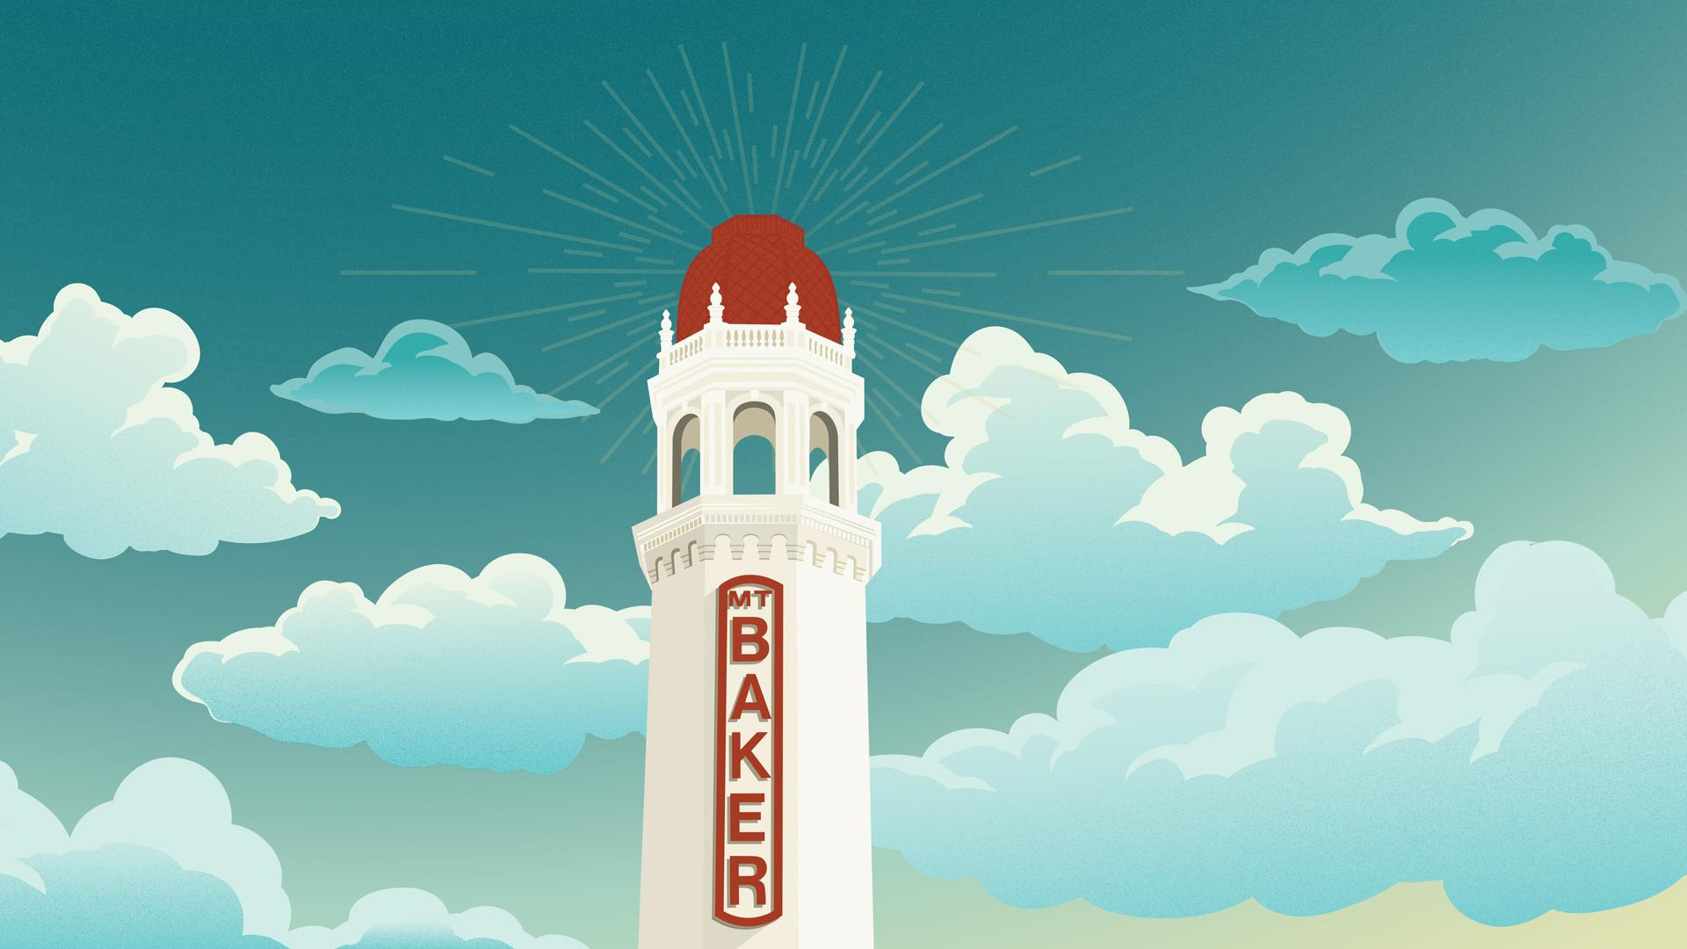
Mount Baker Theatre 2024-2025
Public Facilities District September 18, 2025

Slide 2
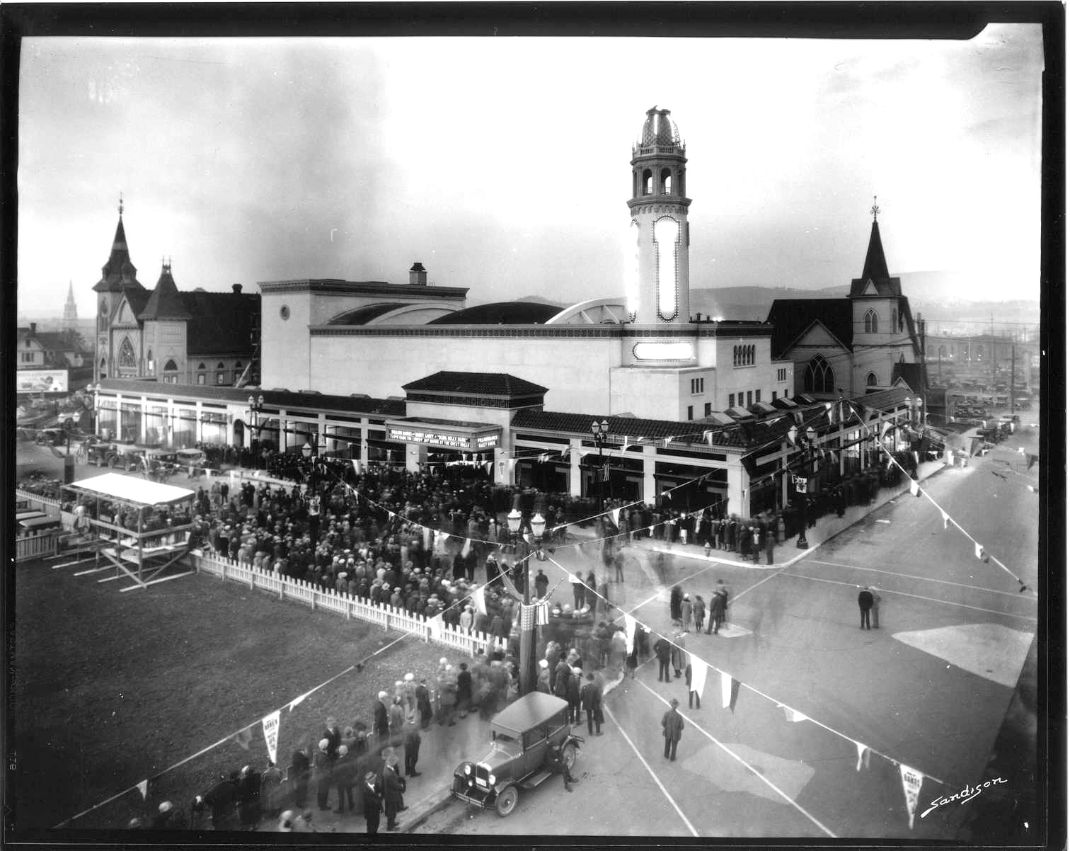
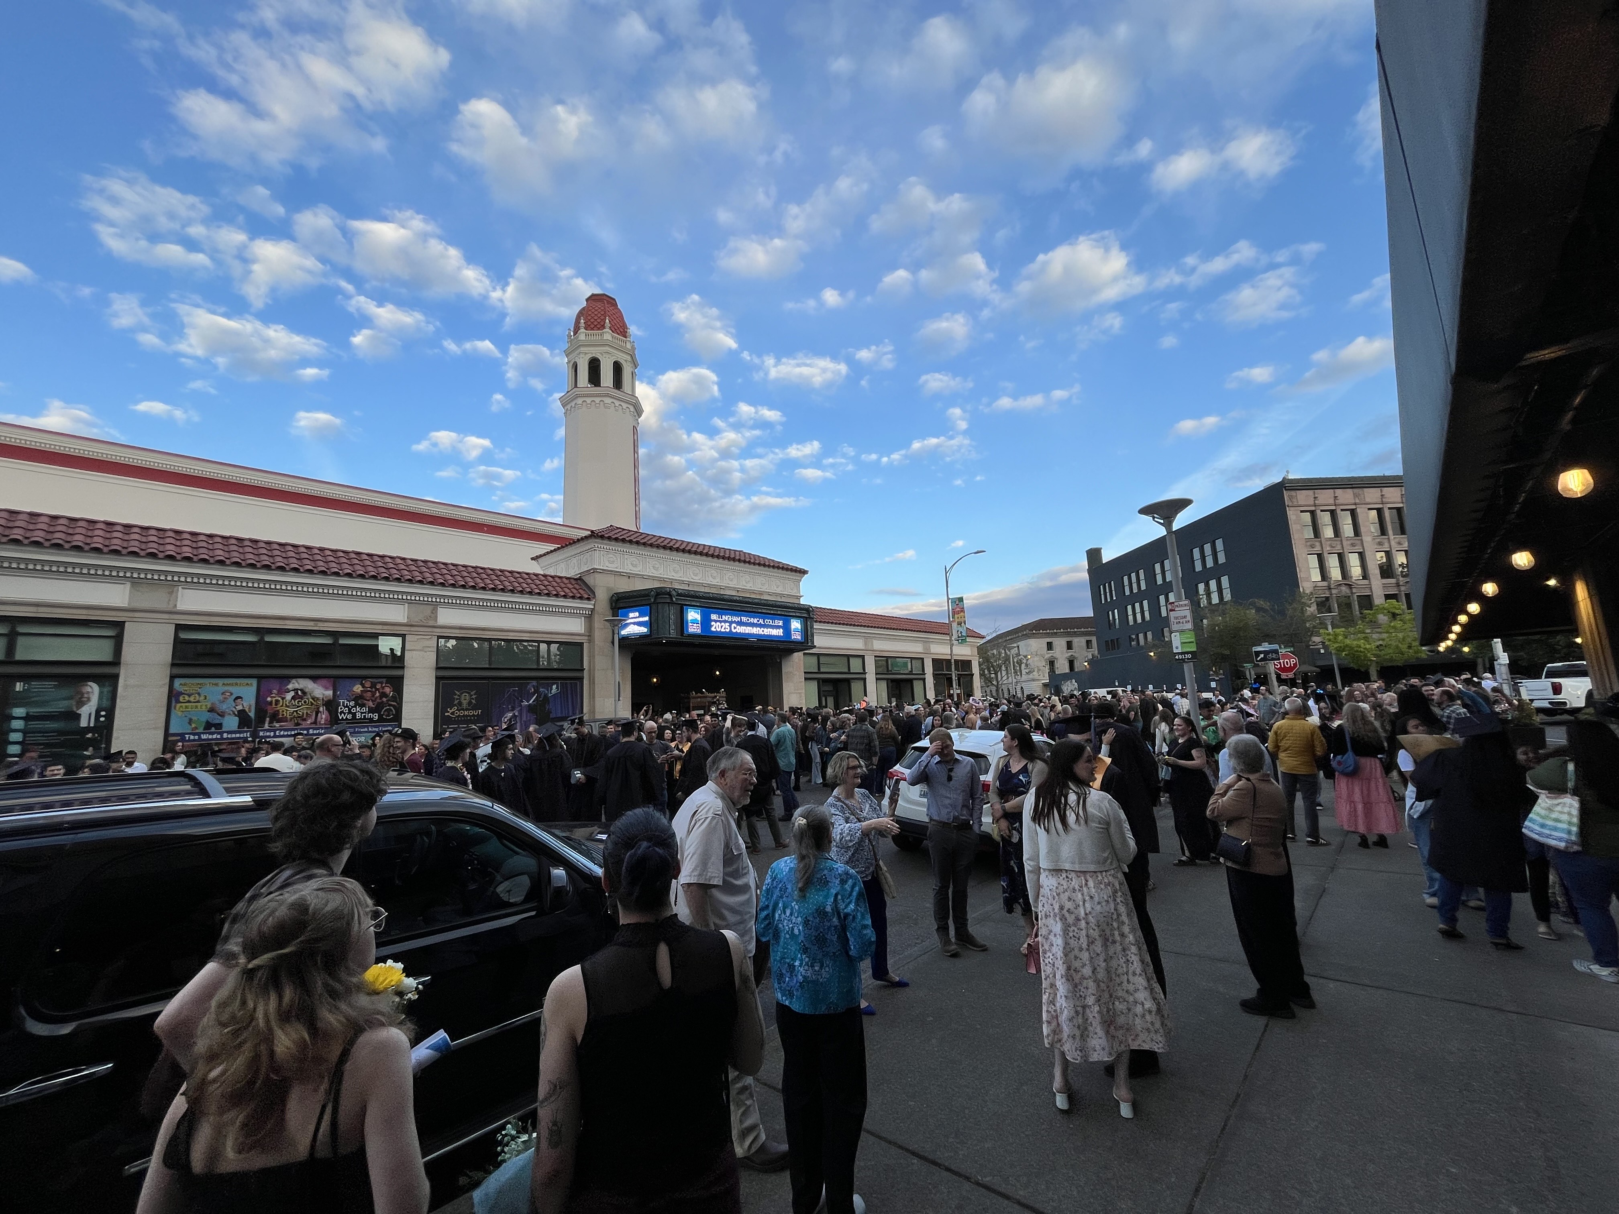
Mount Baker Theatre: A Lasting Community Legacy
Opened: April 29, 1927, as a Fox movie palace
Role Then and Now: Downtown Bellingham Draw and Arts District Anchor

Slide 3
Mission
The Mount Baker Theatre Organization enriches our region’s culture through dynamic performances, arts education, inspiring engagement in the community, and stewardship of a national historic treasure.

Slide 4
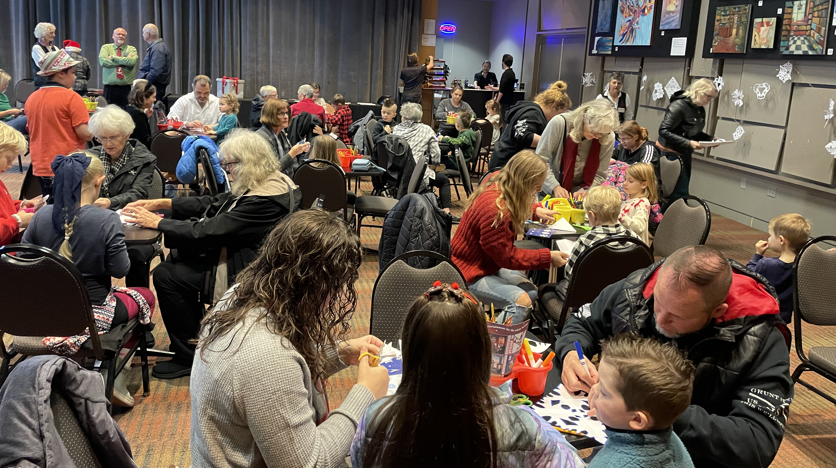
Vision
We are continuously improving our region’s quality of life by:
Increasing the frequency, breadth, and value of our community’s engagement in the arts, arts education, and cultural experiences
Strengthening our thriving arts community through collaboration and leadership
Contributing to the growth of cultural heritage tourism

Slide 5
Mount Baker Theatre
Attendance & Reach

Slide 6
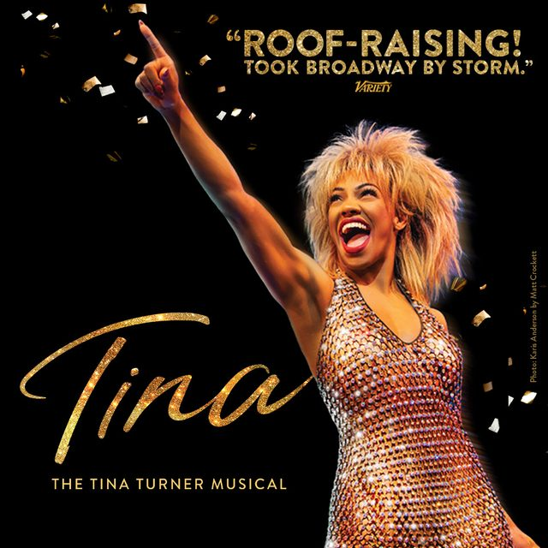
Attendance and Reach
 | FY 24-25
Ticketed Events | 135
Total Tickets | 109,145
From 50+ Miles | 17,916
% from 50+ | 16%
Non-Ticket Attendance | 7,164
Total People Served | 116,309
Notes:
3,000 more tickets total, but 2,179 more from 50+ is 14% growth!

Slide 7
Mount Baker Theatre
Events – Arts Education

Slide 8
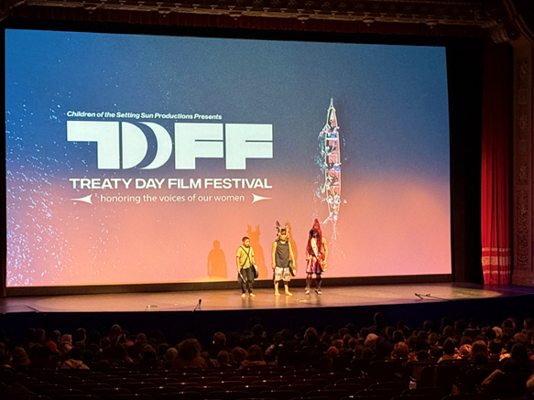
Arts Education
 | FY 24-25
Ed Series | 15
TDFF | 5
MCT weeks | 1

Slide 9
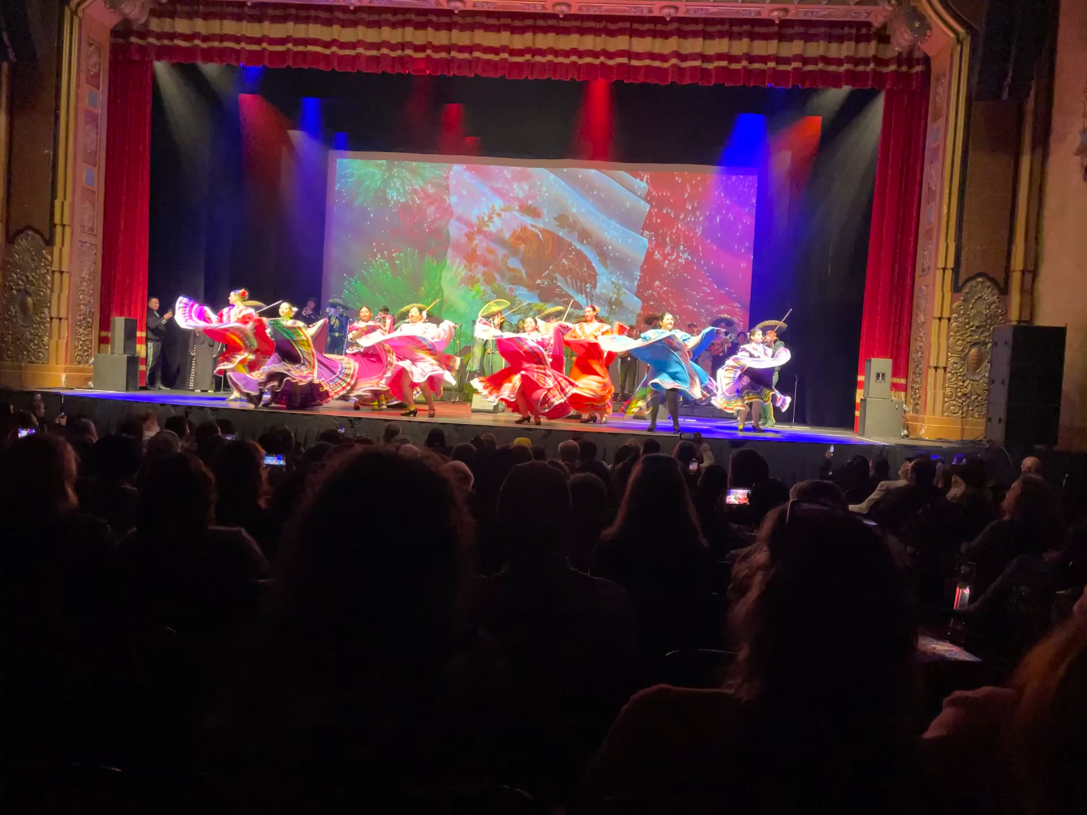
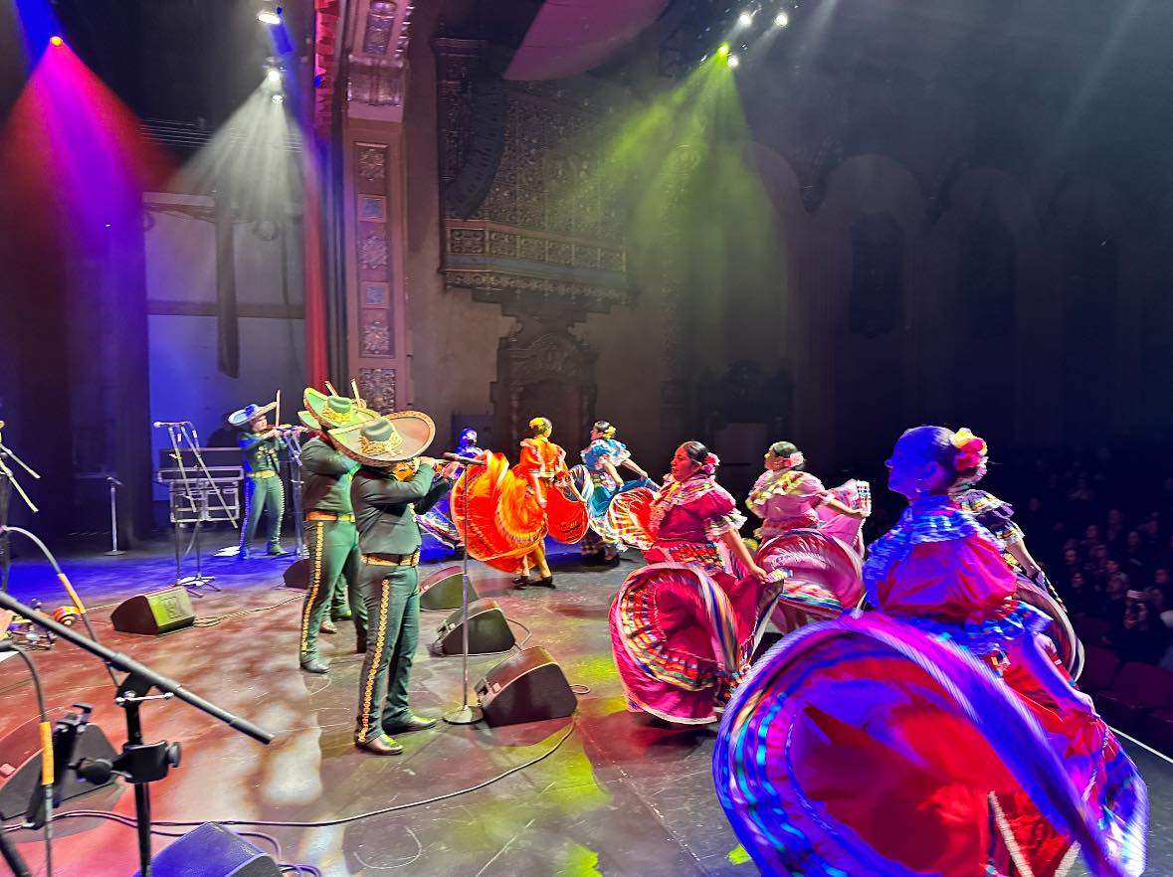
Arts Education – Expanded Programming
Community Enrichment (4)
Senior Enrichment (3)
Teacher Appreciation (2)
Family Art Studios (2)
Professional Development (1)
Student Workshops (1)

Slide 10
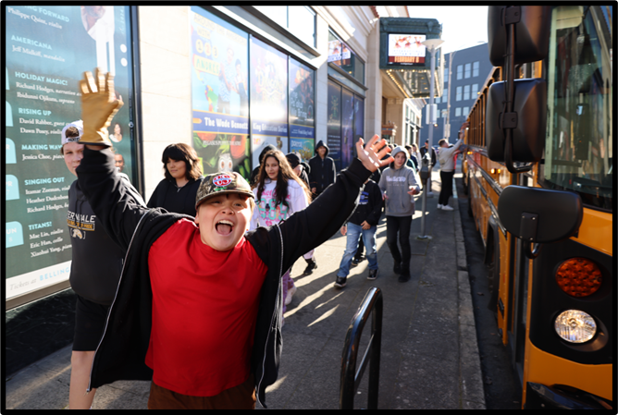
Arts Education Summary
 | FY 24-25
Students Served | 11,859
Schools | 78
School Districts | 15
Counties | 4

Slide 11
Mount Baker Theatre
Main Stage and Walton

Slide 12
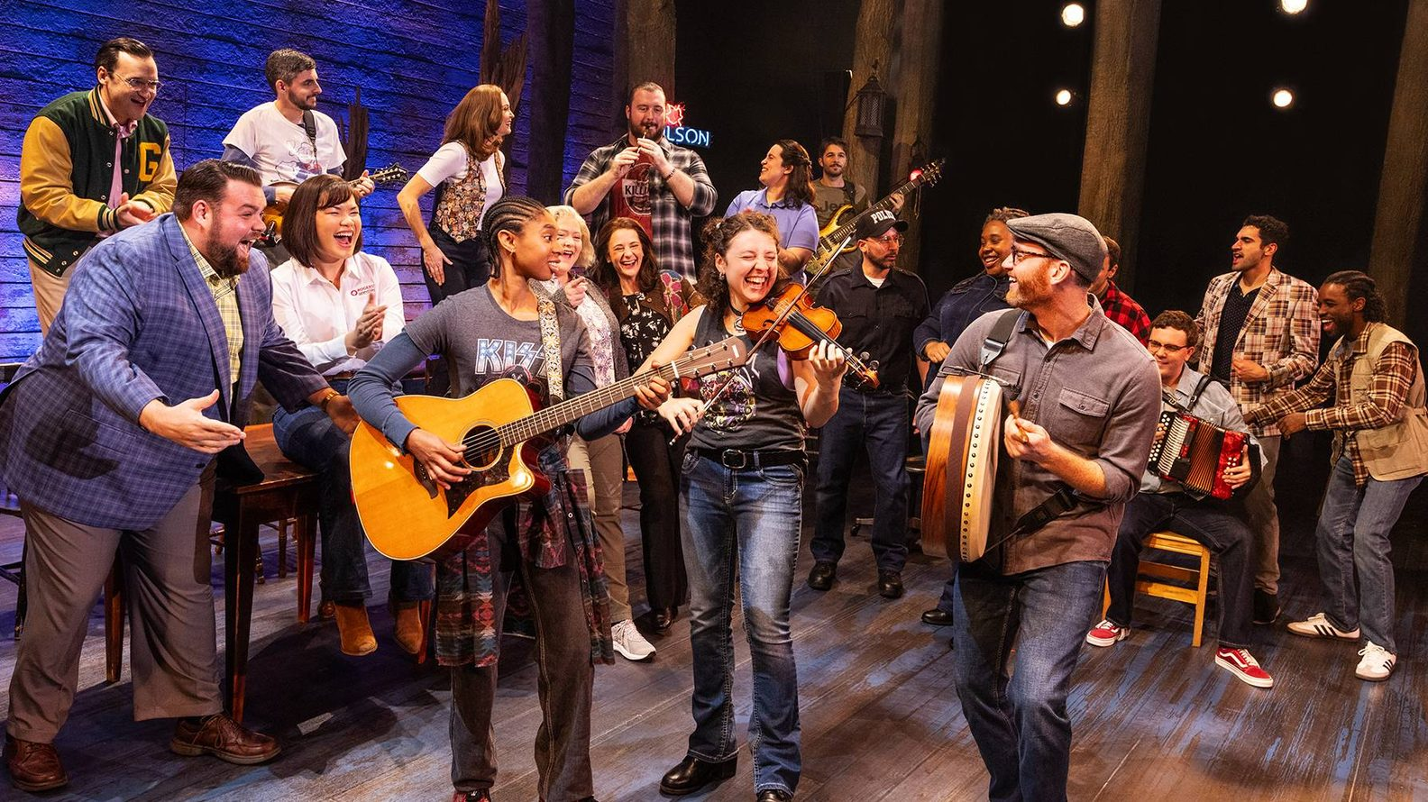
MBT Presents – Main Stage
 | FY 25
Broadway Performances | 7
Main Stage Total | 41
Tickets | 44,427
Notes:
Significant calculated risk booking a 2-night Broadway show was a success.

Slide 13

MBT Presents – Walton
 | FY25
Performances | 22
Tickets | 2,883
Notes:
“Out of the Box” theatrical series was not popular or cost-effective and has been quietly phased out.

Slide 14
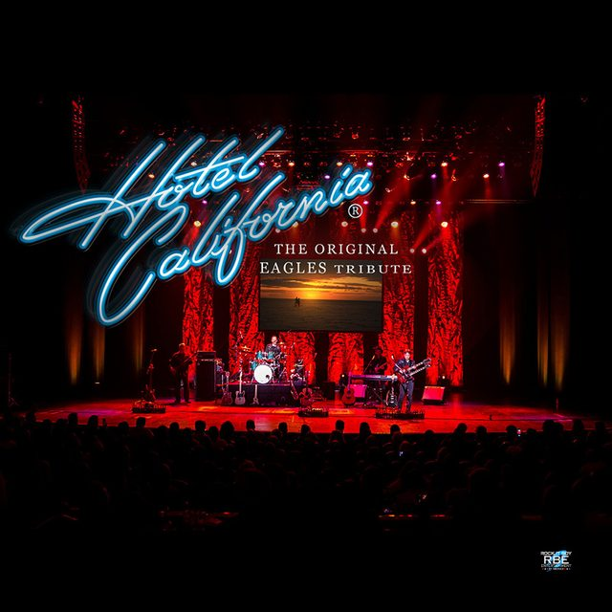
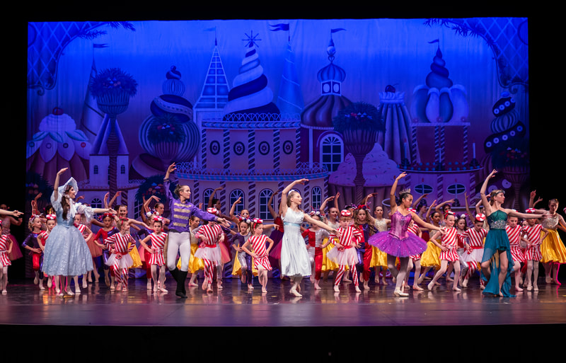
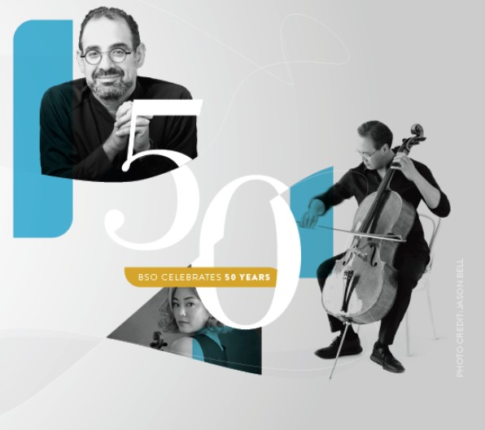
Ticketed Events by Renters
 | FY 25
Events | 55
Tickets | 52,175
Notes:
Rentals account for almost 50% of our attendance

Slide 15
Mount Baker Theatre
Economic Impact

Slide 16
Americans for the Arts:
Arts & Economic Prosperity 6
Arts and Culture sector generated $151.7 billion in economic activity
$73.3 billion in org spending
$78.4 billion in audience spending
2.6 million jobs, $29.1 billion in tax revenue, and $101 billion in personal income.
REFERENCE: https://nmculture.org/assets/files/reports/AEP6_NationalReport.pdf
Notes:
The most recent report from a 30-year national study by the Americans for the Arts.

Slide 17
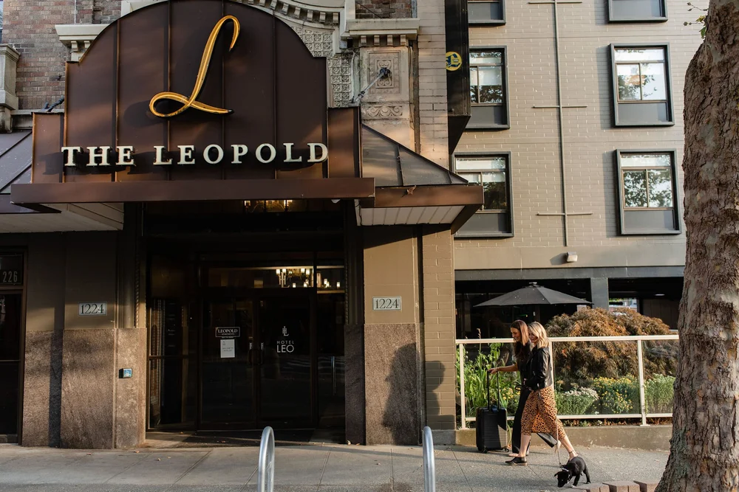
Local Economic Activity: Audience Spending
$3,482,000 = estimated audience spending in local economy beyond admission
($35 avg. x 99,500 non-education attendees)
REFERENCE: https://nmculture.org/assets/files/reports/AEP6_NationalReport.pdf
Notes:
22% of MBT audiences, 13% of rental audiences are from 50+ miles away
Every event brings multiplier effects through food, lodging, retail, and transit - especially for out-of-town visitors.
Investment in the arts yields direct returns in economic output, AND in community identity, youth engagement, and tourism.

Slide 18
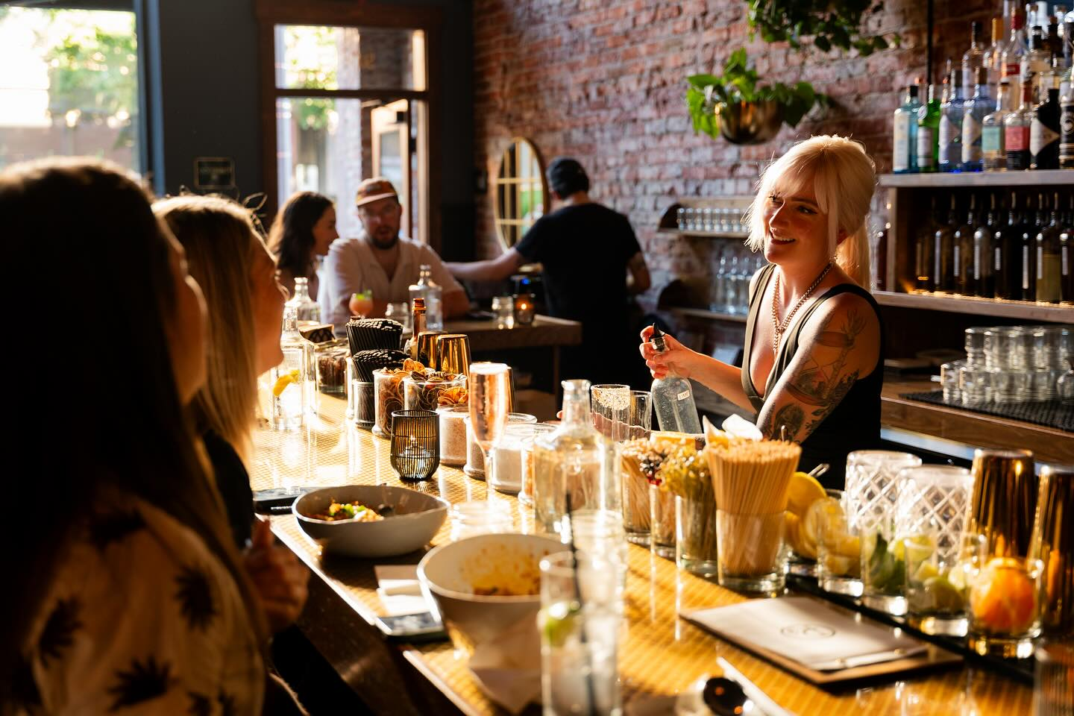
Local Economic Impact: Jobs
Local jobs created by MBT spending = 162
Local jobs from additional audience spending = 47
MBT alerts 50+ local businesses monthly of upcoming schedule & projected attendance
REFERENCE: https://nmculture.org/assets/files/reports/AEP6_NationalReport.pdf
Notes:
These are estimated annual average headcounts of
full-time, part-time, and seasonal employment,
and therefore, not full-time equivalent (FTE) numbers.

Slide 19
Local Economic Impact: testimonial
“Mount Baker Theatre has had an immense impact on Redlight’s success since moving to Grand Ave two years ago.
On show nights, we see a significant increase in foot traffic and business. MBT is the anchor of the Arts District and we’re lucky, and proud, to be their neighbor.”
Logan McQuaig, Owner

Slide 20
Mount Baker Theatre
Finances

Slide 21
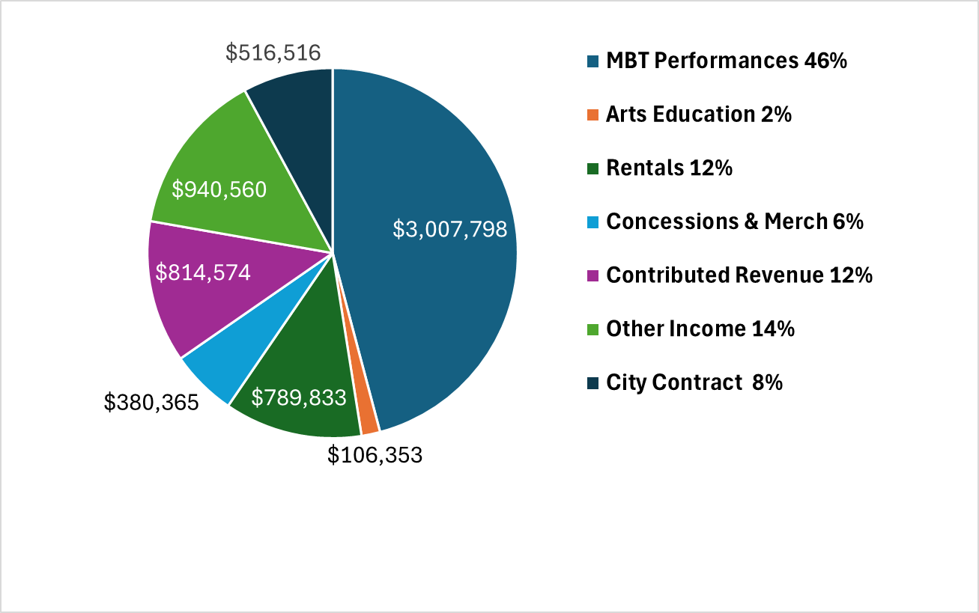
Finance
2024-2025
Operating
Revenue
& Support
$6,555,998
*
*Includes $599,000
of non-recurring income
Notes:
Double check numbers with Matt

Slide 22
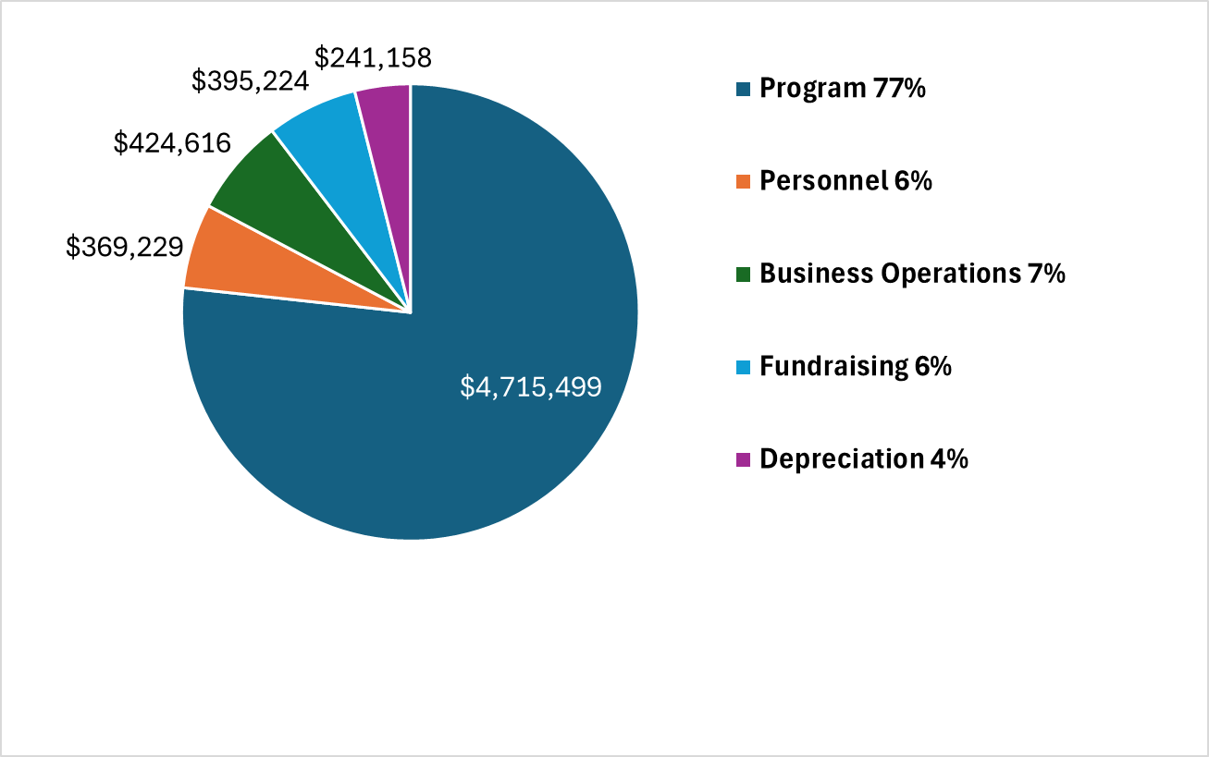
Finance
2024-2025
Operating
Expenses
$6,145,725

Slide 23
Finance Summary - Unaudited results
 | FY 24-25
Total Income | $6,555,998
Total Expenses | $6,145,725
Net | $410,273
Adjusted Net | $38,467
Notes:
Adjusted Net is derived by removing non-recurring income ($599k) and depreciation expense ($241k). These are not audited results yet, but we believe they are accurate.

Slide 24
Mount Baker Theatre
FUNDRAISING

Slide 25
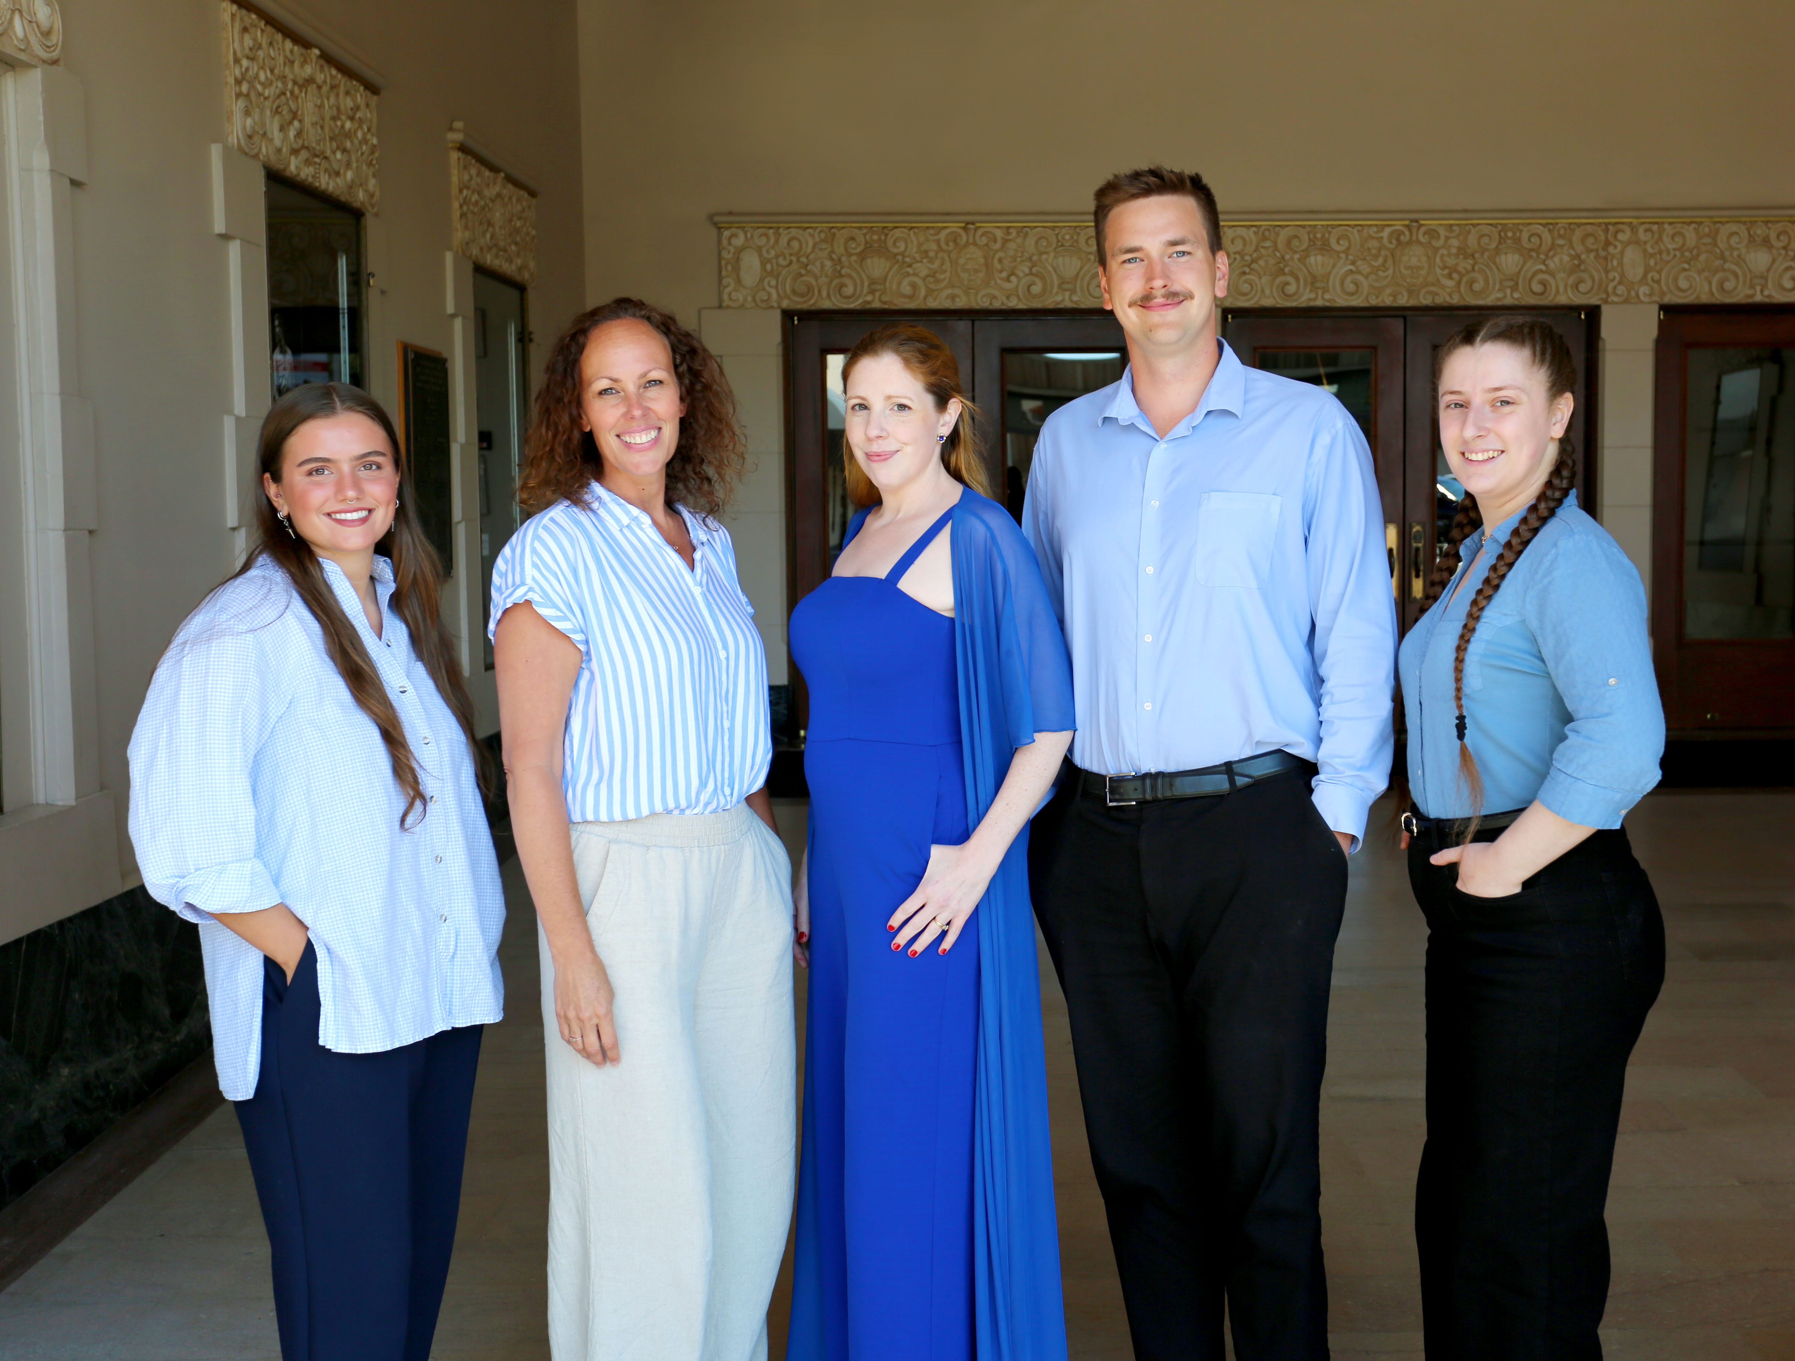
Fundraising FY24-25 total: $814,574
Does not include City contract
26 Sponsors
1,700
Member Households
Grants
Education Fund
Capital Fund
Notes:
We seek many sources of support. 2nd year of record-breaking number of Member households and donations!

Slide 26
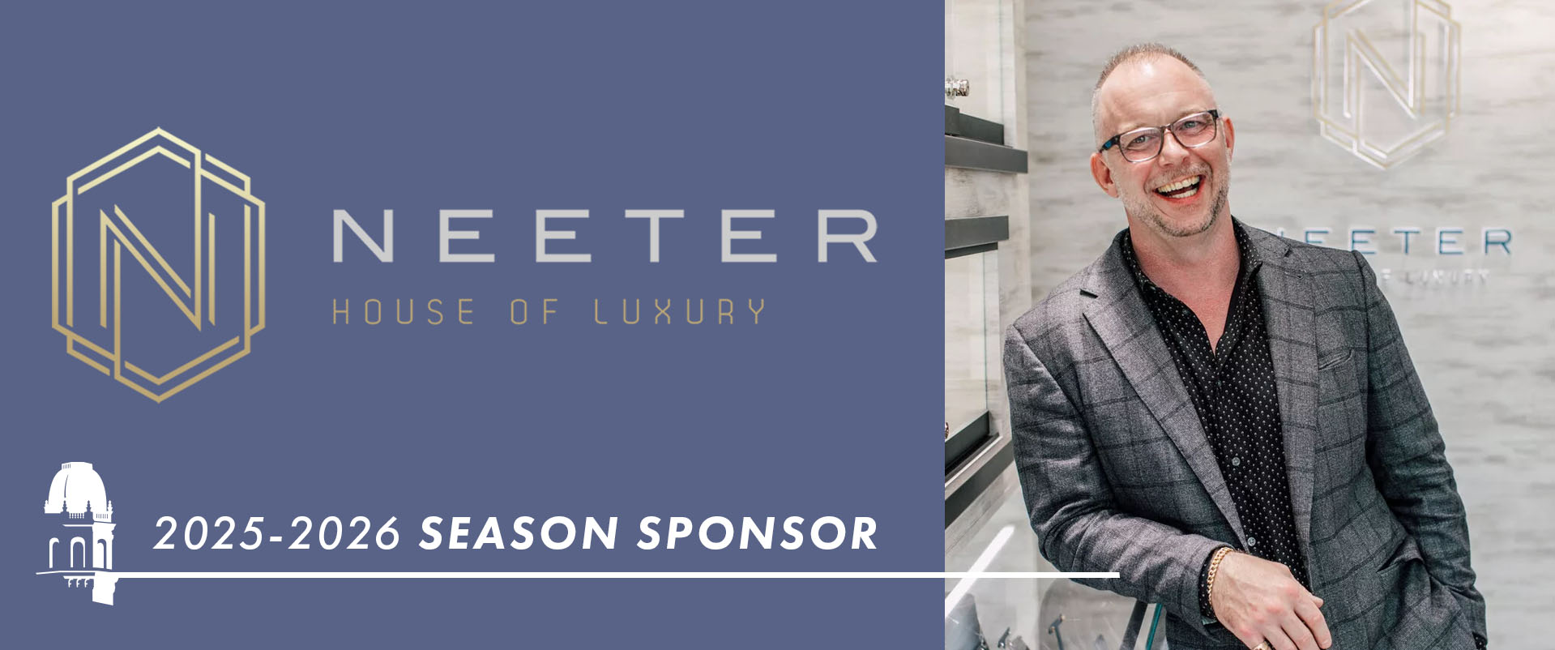
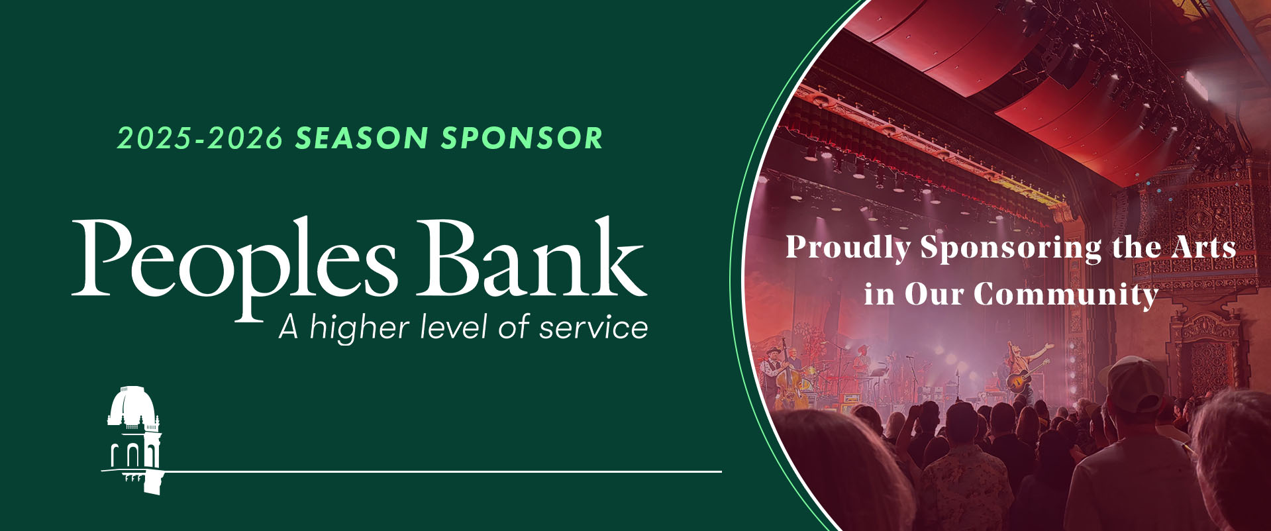
Season Sponsors
Notes:
2 Season Sponsors!

Slide 27
Mount Baker Theatre
1927 - 2027

Slide 28
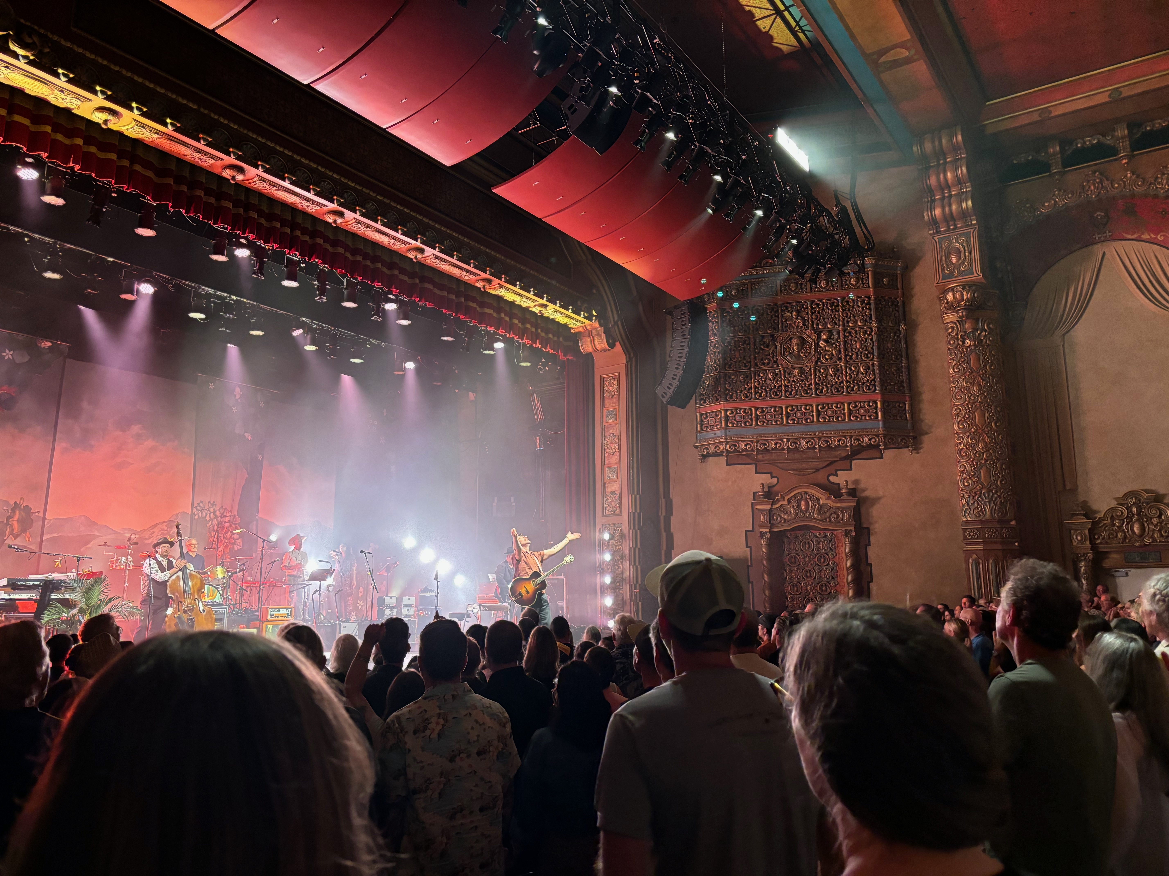
Preparing for MBT’s Centennial
Seeking input in planning our 100th Season
Expect even more Broadway & bigger headliners
Replacing auditorium seats & carpet
Final phase of roof replacement
Restoring Wurlitzer organ & lift

Slide 29
COB – BWPFD - MBT Relationship

Slide 30
Agreements between BWPFD, MBT and City
Transfer Agreement, 2005
MBT transferred from City to PFD
Value of the building considered local “match’
City has maintenance obligation
Lease Agreement, 2005
BWPFD (landlord) and MBT (tenant)
Amended in 2018 to extend the term through 2042
Management Services Agreement, Annual
City pays MBT to manage the PFD-owned Tourism-related Facility
~ $550,000 per year / lodging tax

Slide 31
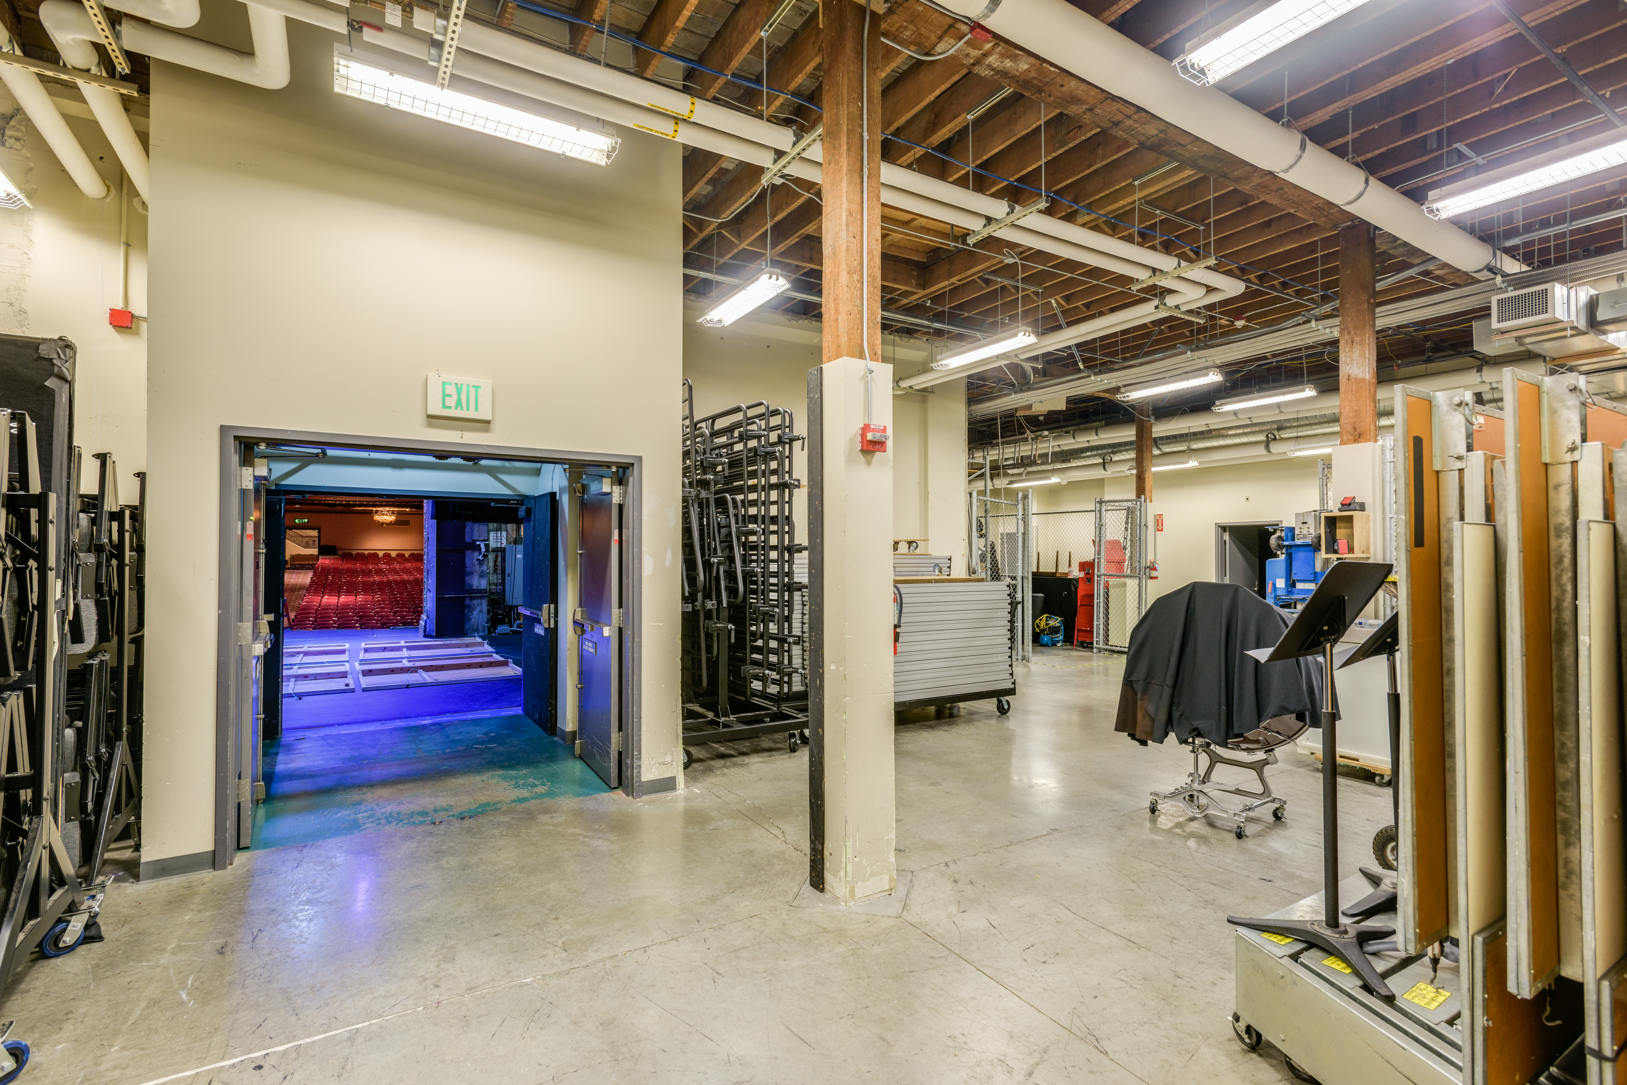
Prior Capital Work – PFD Funded
2003 PFD purchased Commercial St condos for Phase 1
Created Studio Theatre (later renamed Henry & Irene Walton Theatre), new dressing rooms, green room, and storage
2008 Phase II Renovation
HVAC & Electrical upgrades, restored carpeting, lobby & auditorium plaster and paint

Slide 32
Prior Capital Work
Sample projects funded by City, State and/or Private fundraising:
MBT Purchased
New seats, sound system, lighting, portion of roof replaced
Champion St condos converted into the Encore Room
1st phase of roof replacement, 2nd new sound system, new projector
Seal and repaint exterior walls
2nd phase of roof replacement, new marquee, new loading dock
Encore room and lobby carpet replaced
Epoxy coating in the foyer

Slide 33
Mount Baker Theatre
CAPITAL NEEDS

Slide 34
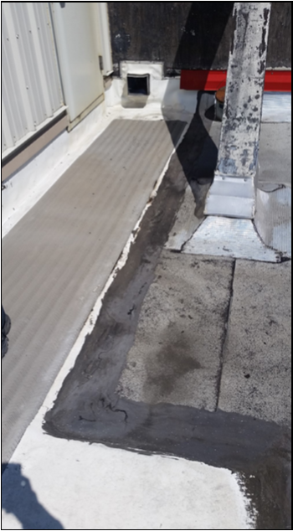
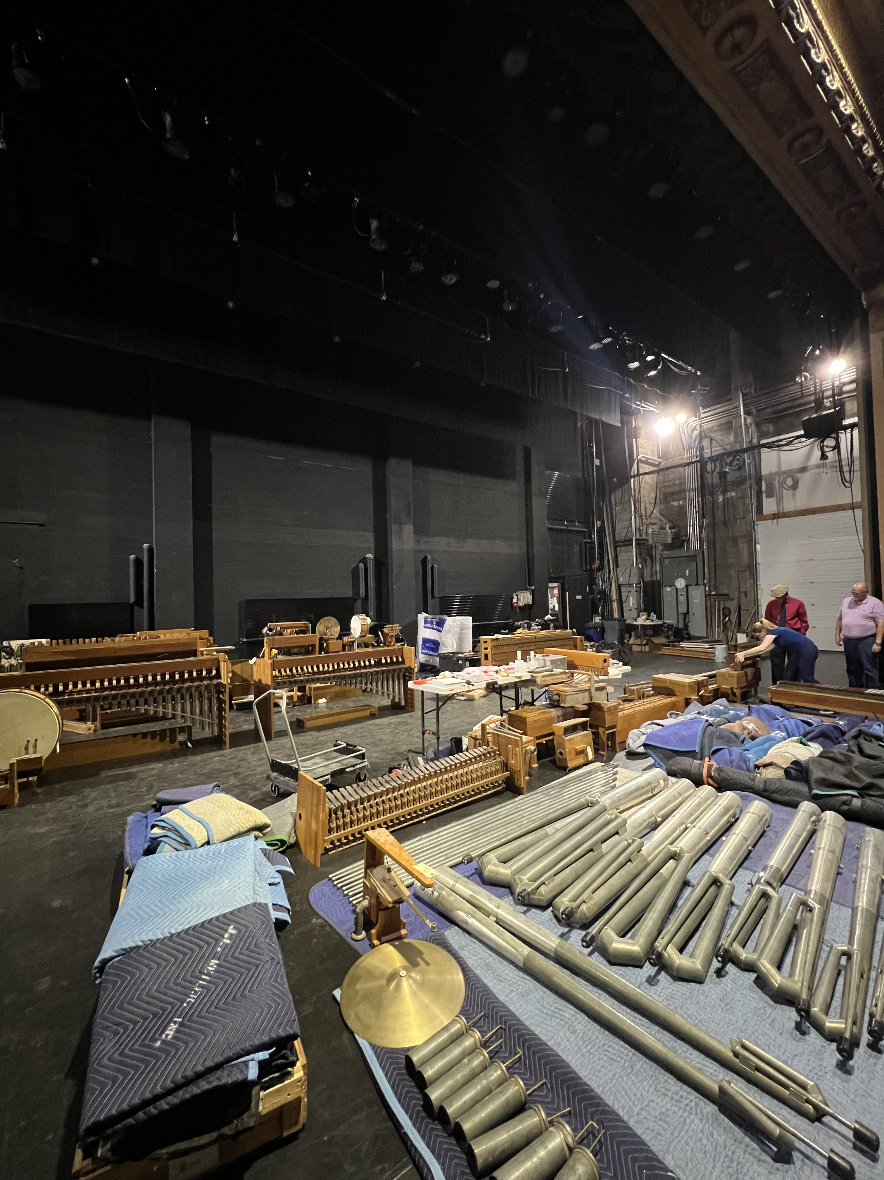
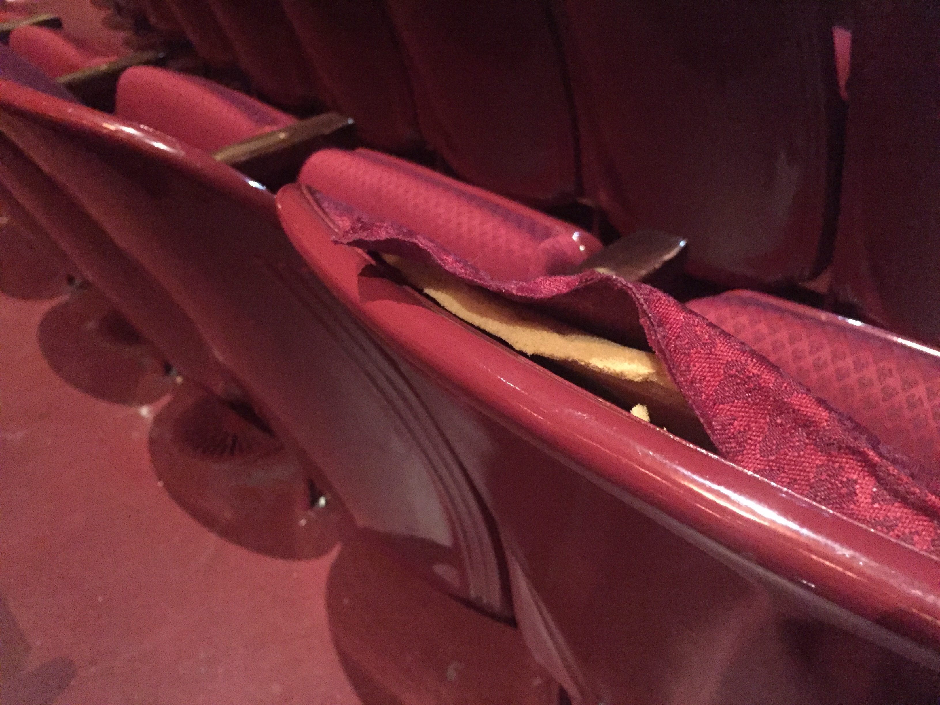
Capital Needs: Short Term (>2 years)
Projects needed (FY 2025-2026)
Theater Roof Replacement Final Phase: $2,000,000
Auditorium Seat Replacement: $1,253,000
Wurlitzer Organ & Lift Restoration: $745,000
Carpet Replacement: $259,000
Other Centennial Preparations: $115,000
Notes:
Leveraging Funding
MBT secured another $1,000,000 State History Preservation grant for this project
Requires $2,000,000 in matching funds
50% of that match can be PFD/COB funding the roof replacement
MBT is currently raising the other $1,000,000+

Slide 35
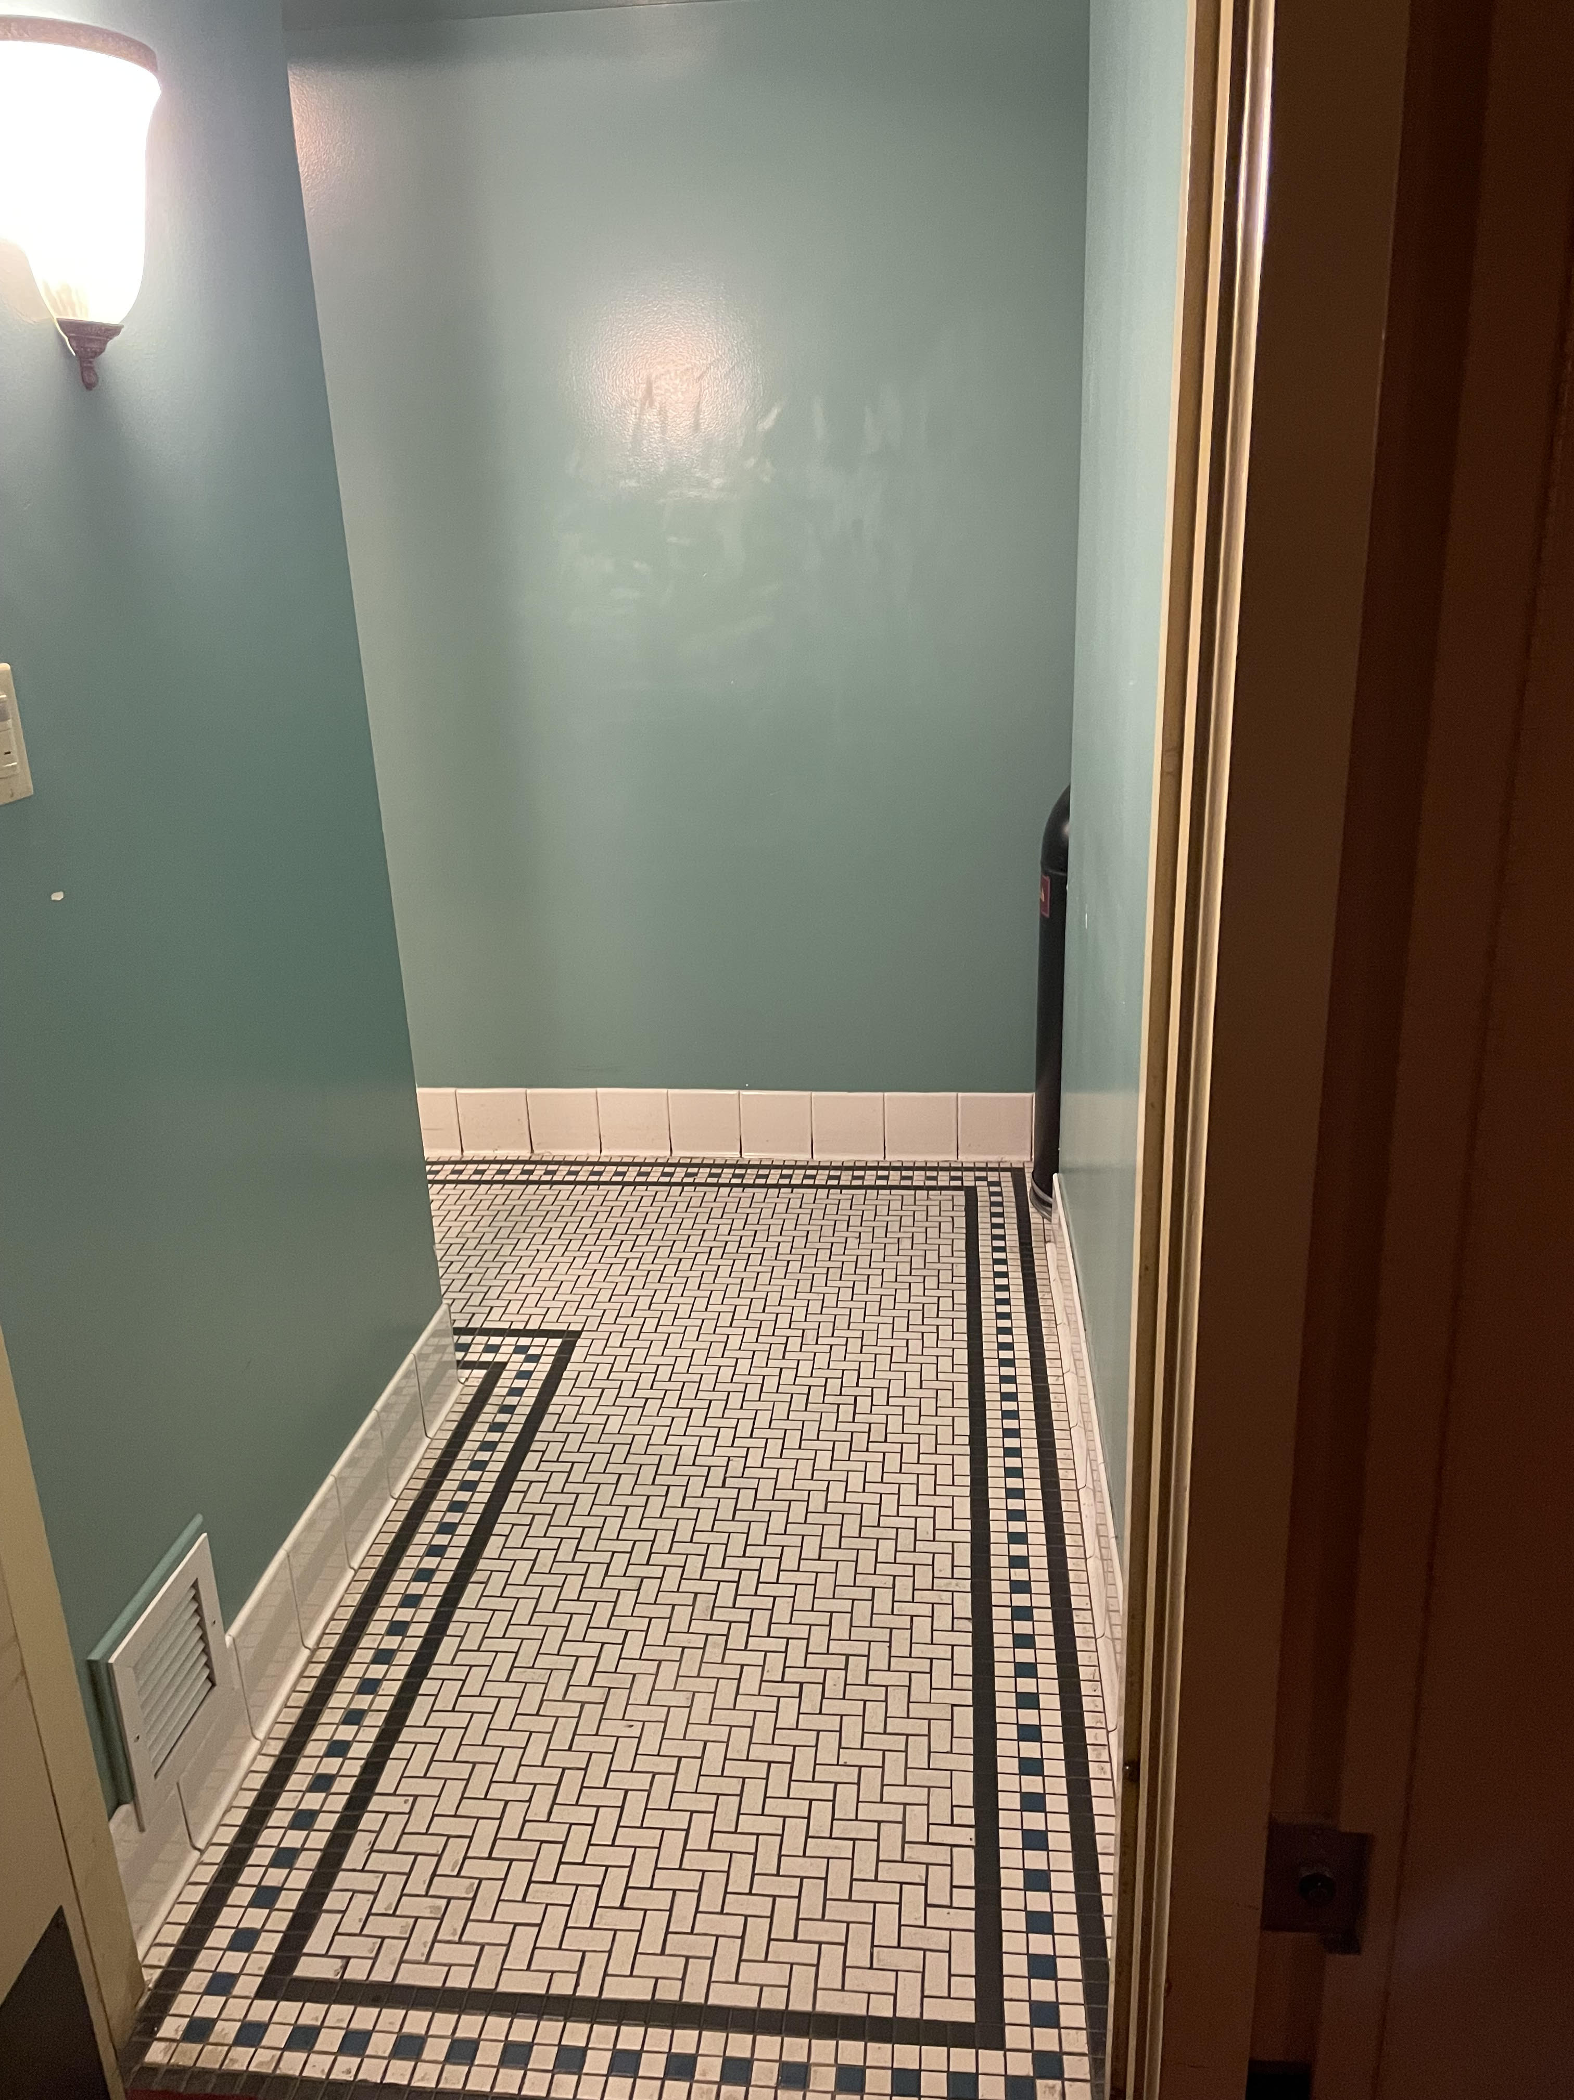
Capital Needs: Short Term (2-8 years)
Upcoming Priorities (FY 2027 - 2035 = $7.1M):
HVAC Equipment & Controls: $2,300,000
Fire Alarm System Replacement & LED Lighting Conversion: $2,200,000
Restrooms & Accessibility Upgrades: $2,600,000

Slide 36
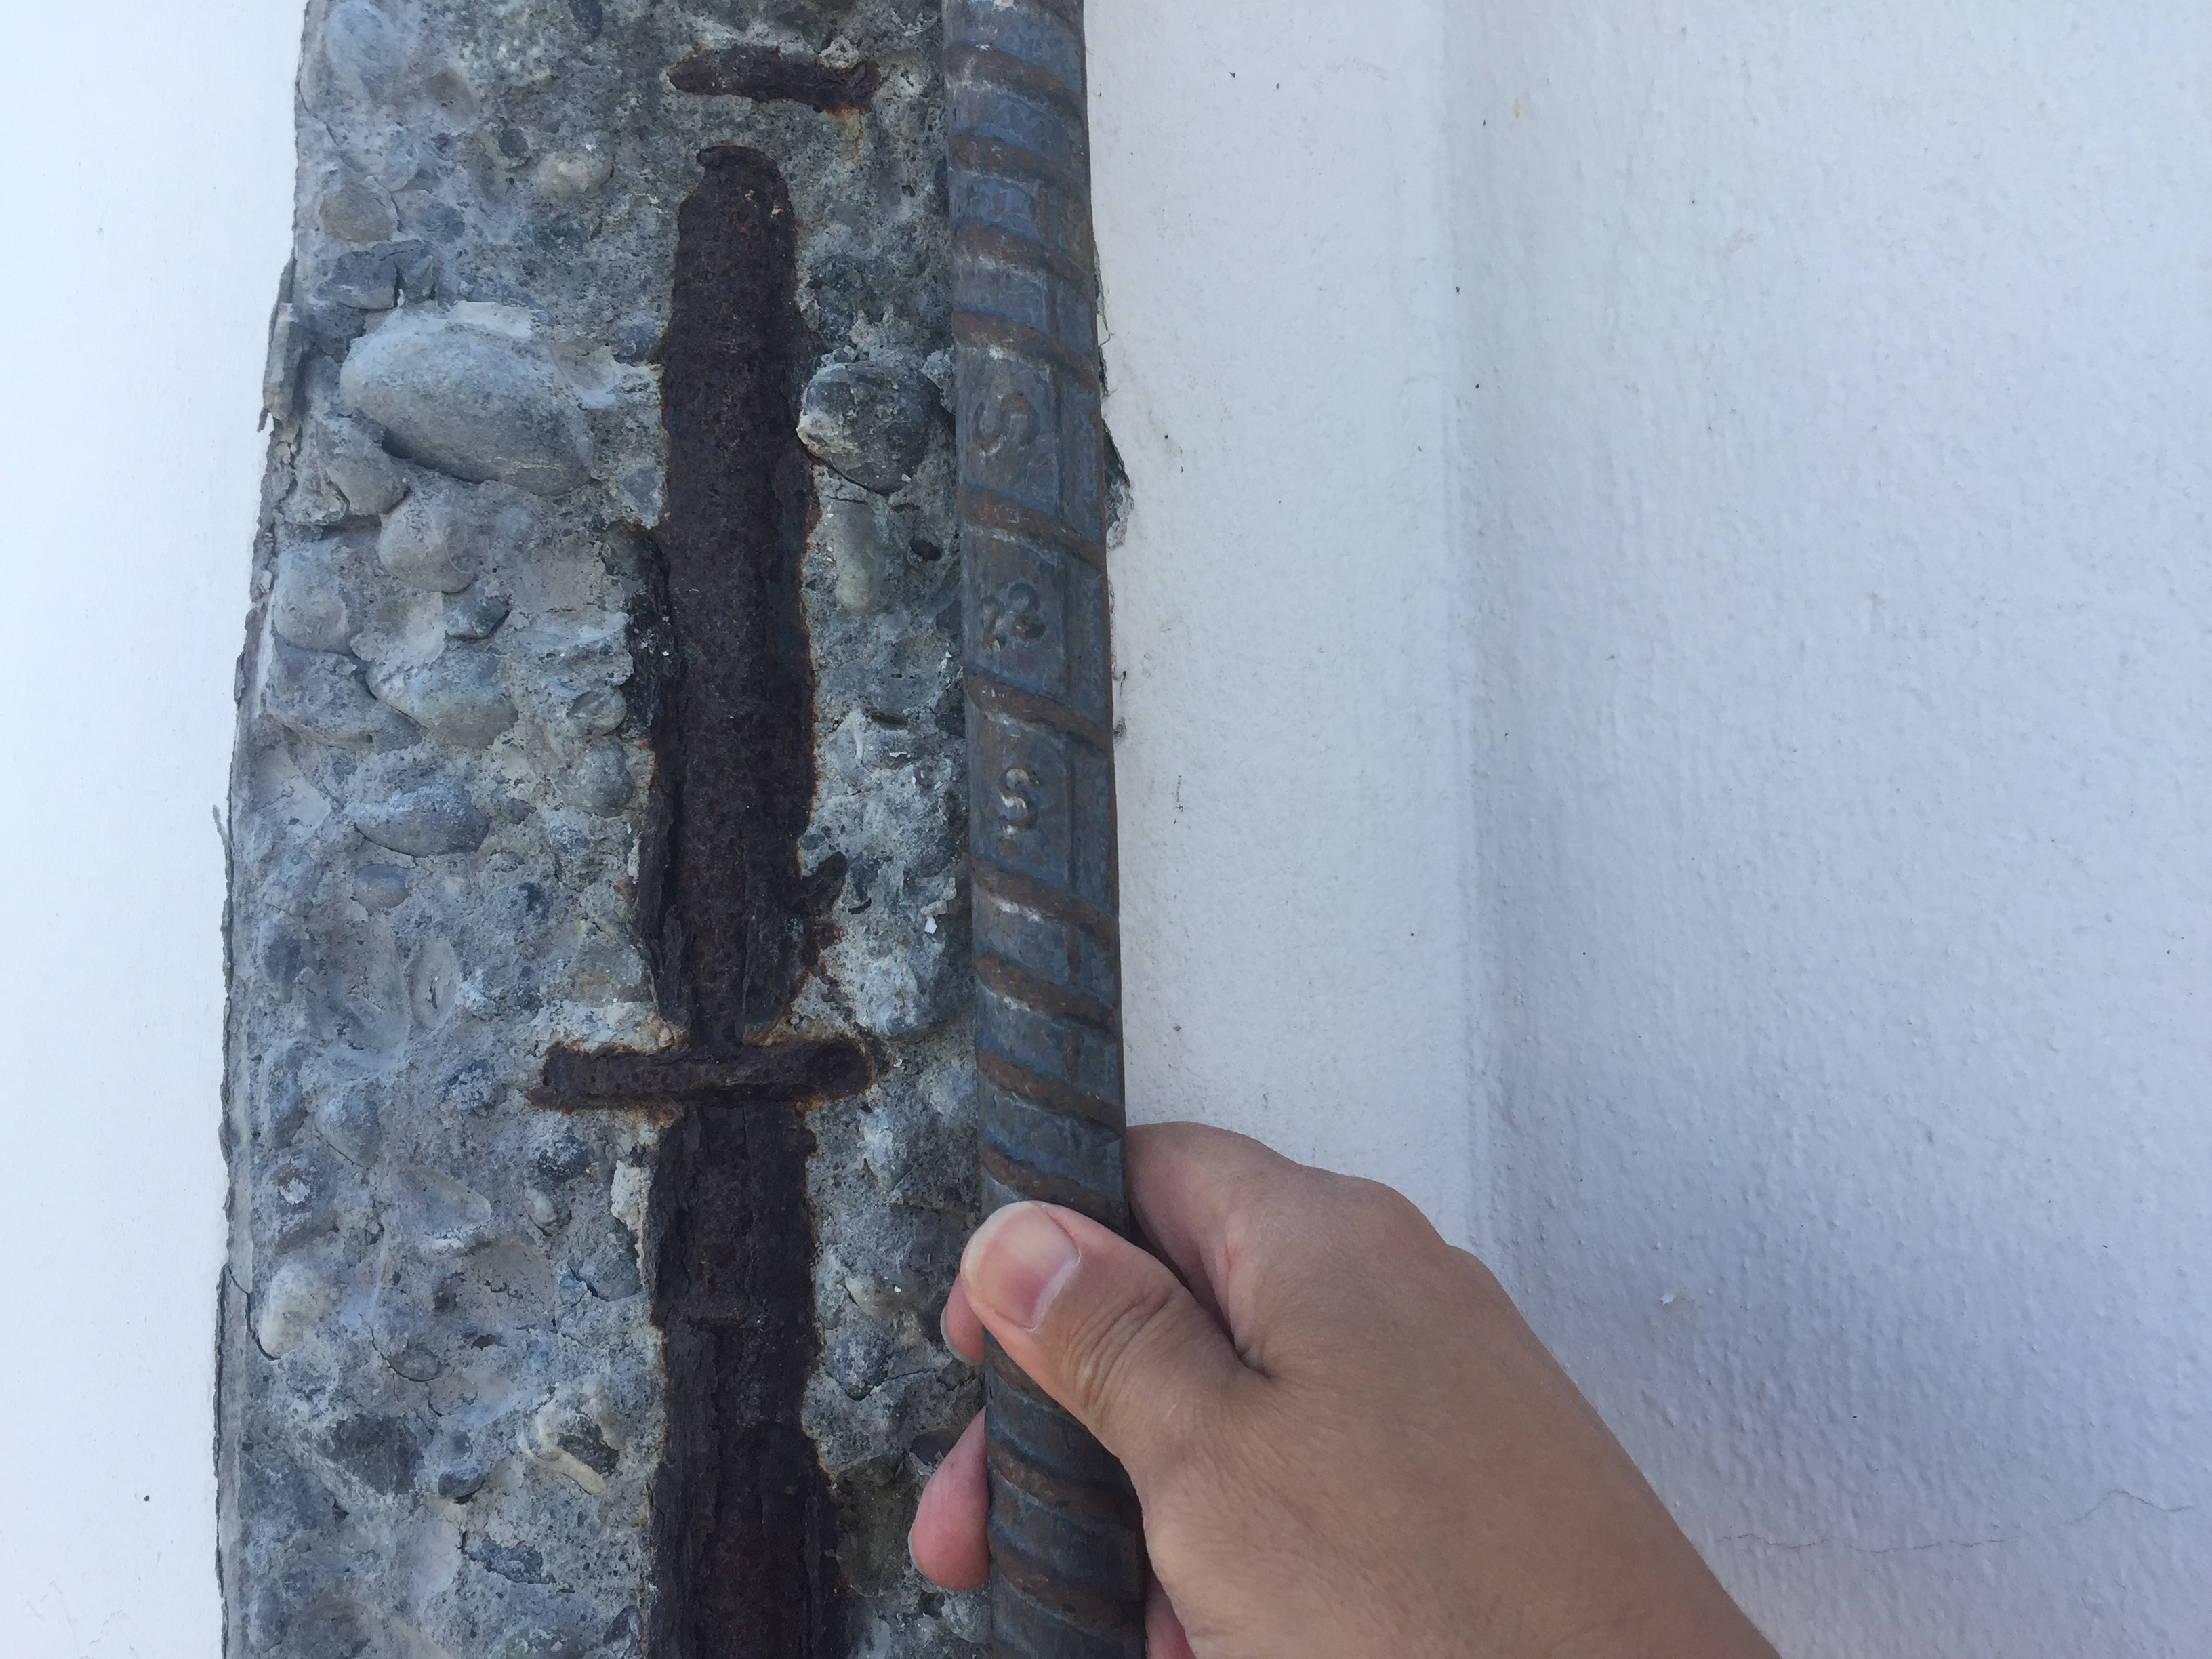
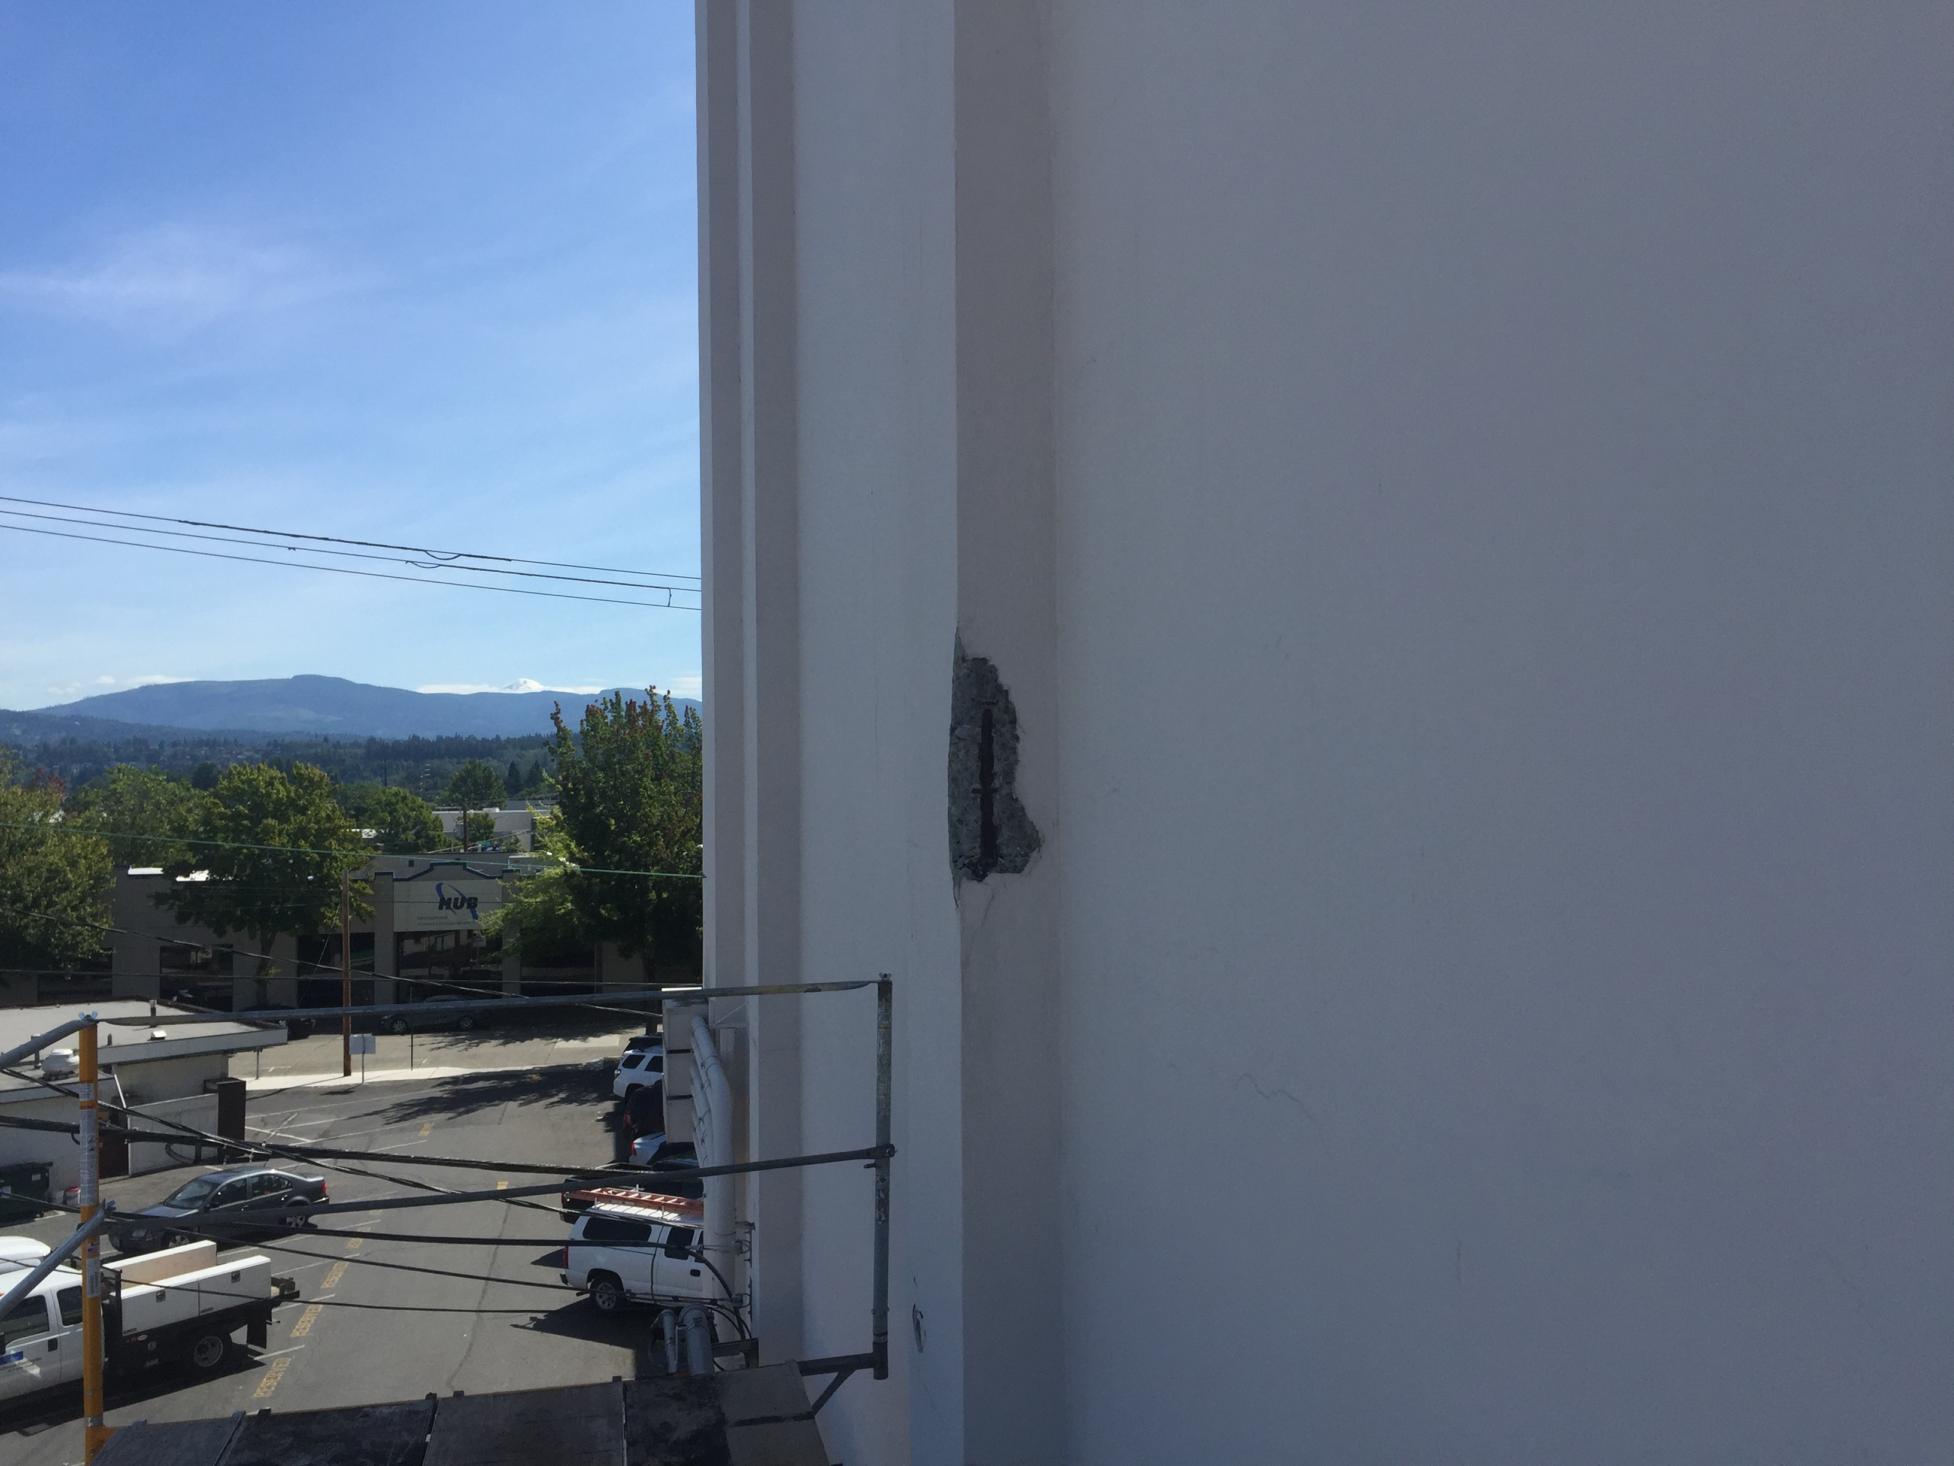
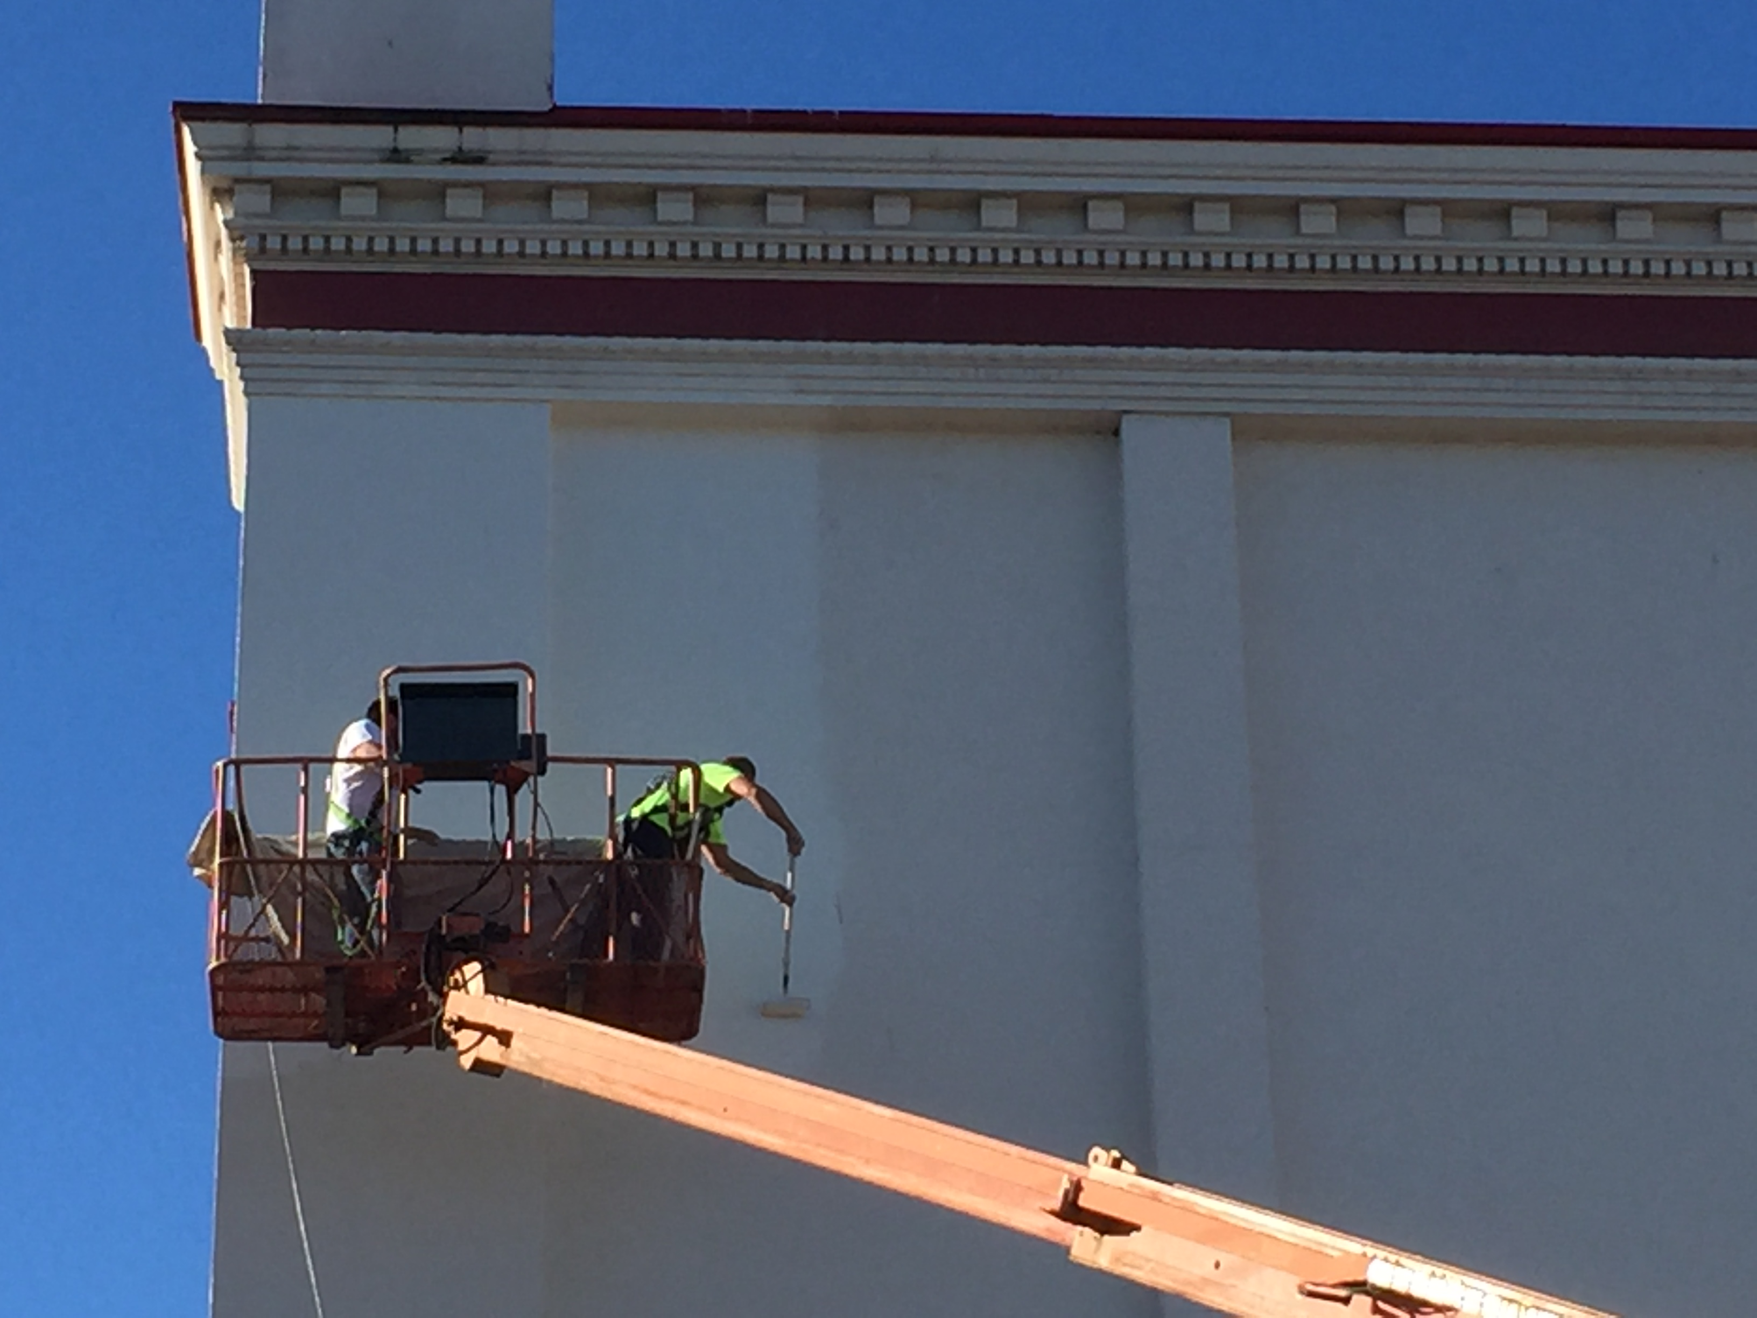
Long-Term Needs: (9-15 years)
FY 2035 - 2040 = $5.2M
Historic Exterior Renewal: $4,000,000
Replacing windows and doors, replastering foyer, and resealing and painting exterior concrete walls and tower
Continuing infrastructure replacement: $1,200,000
HVAC Equipment and related electrical and mechanical
Exterior paint photo
Notes:
There are many other options we can consider envisioning for the long-term future of the theatre, including seismic retrofitting, reconfiguring the back of the house, expanding the stage,

Slide 37
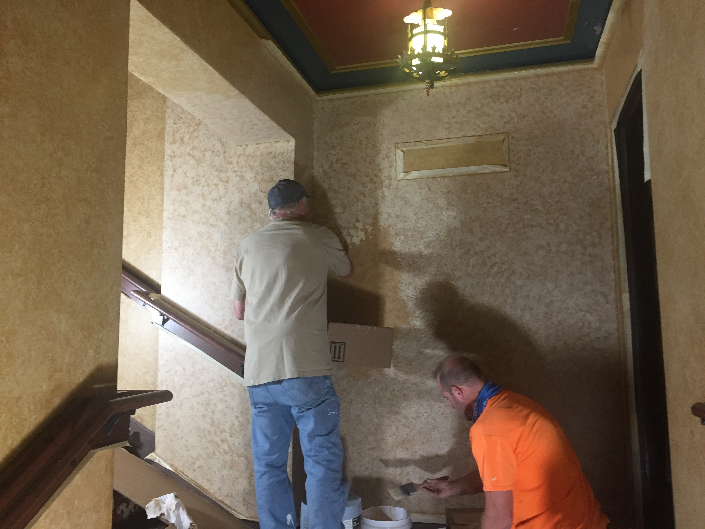
Summary of Capital Costs and Strategy
COB Facilities and MBT Facilities continue to maintain the building by completing smaller projects and repair work within respective operation budgets:
Preventive and ongoing maintenance
Minor repairs of windows, walls, floors

Slide 38
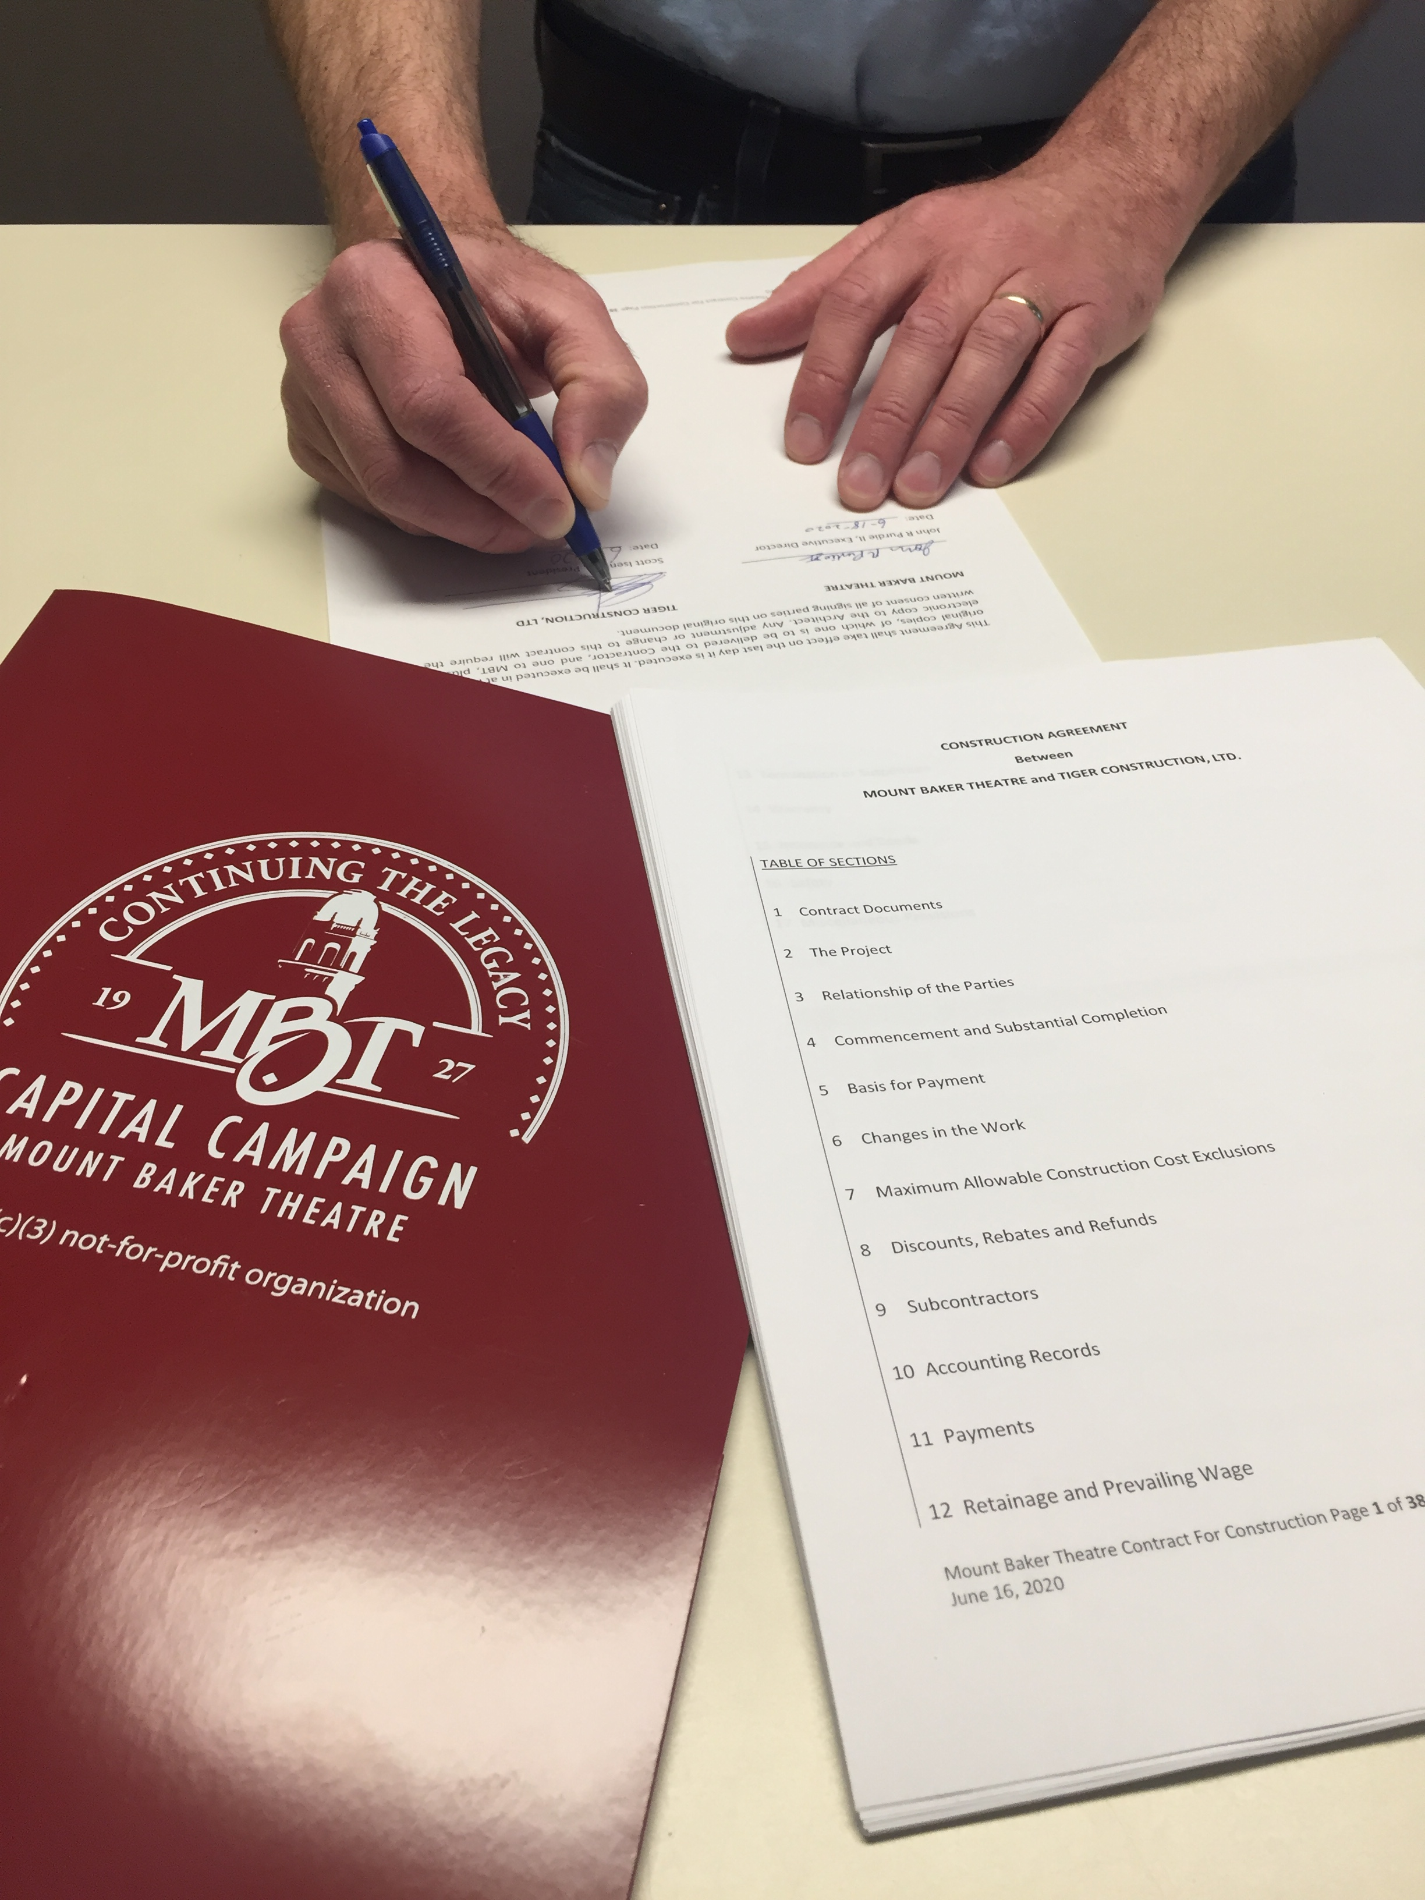
Summary of Capital Costs and Strategy
COB Facilities and MBT Facilities continue to maintain the building by completing smaller projects and repair work within respective operation budgets:
Preventive and ongoing maintenance
Minor repairs of windows, walls, floors
Projections over the next 20 years include 14.3 million in major capital costs.
Strategic planning and evaluation of highest priority capital work
Evaluating scope to match funds available each year
Identifying grants and other opportunities for external funding

Slide 39
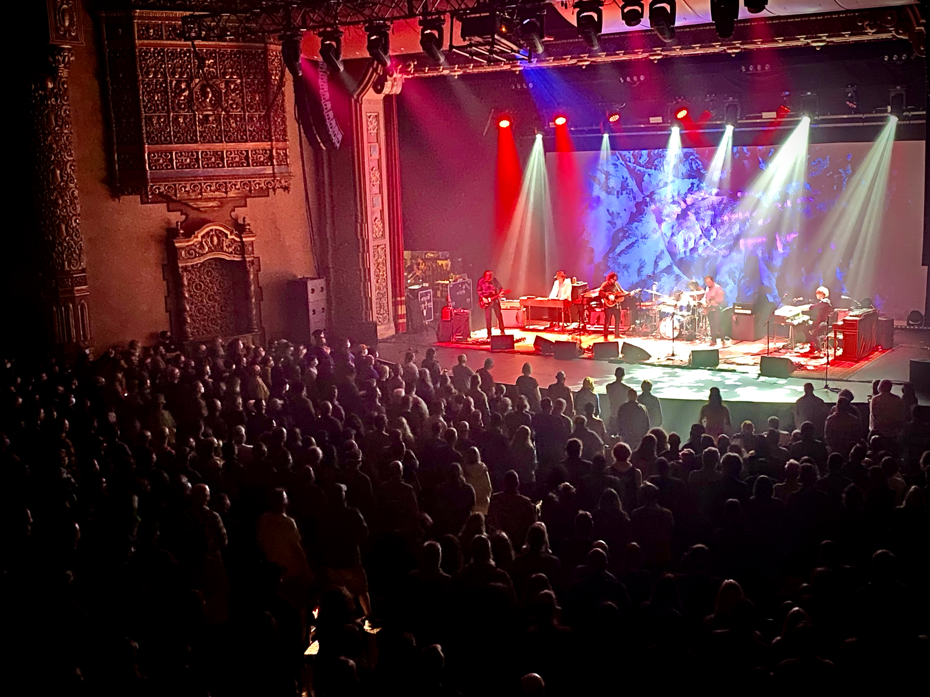
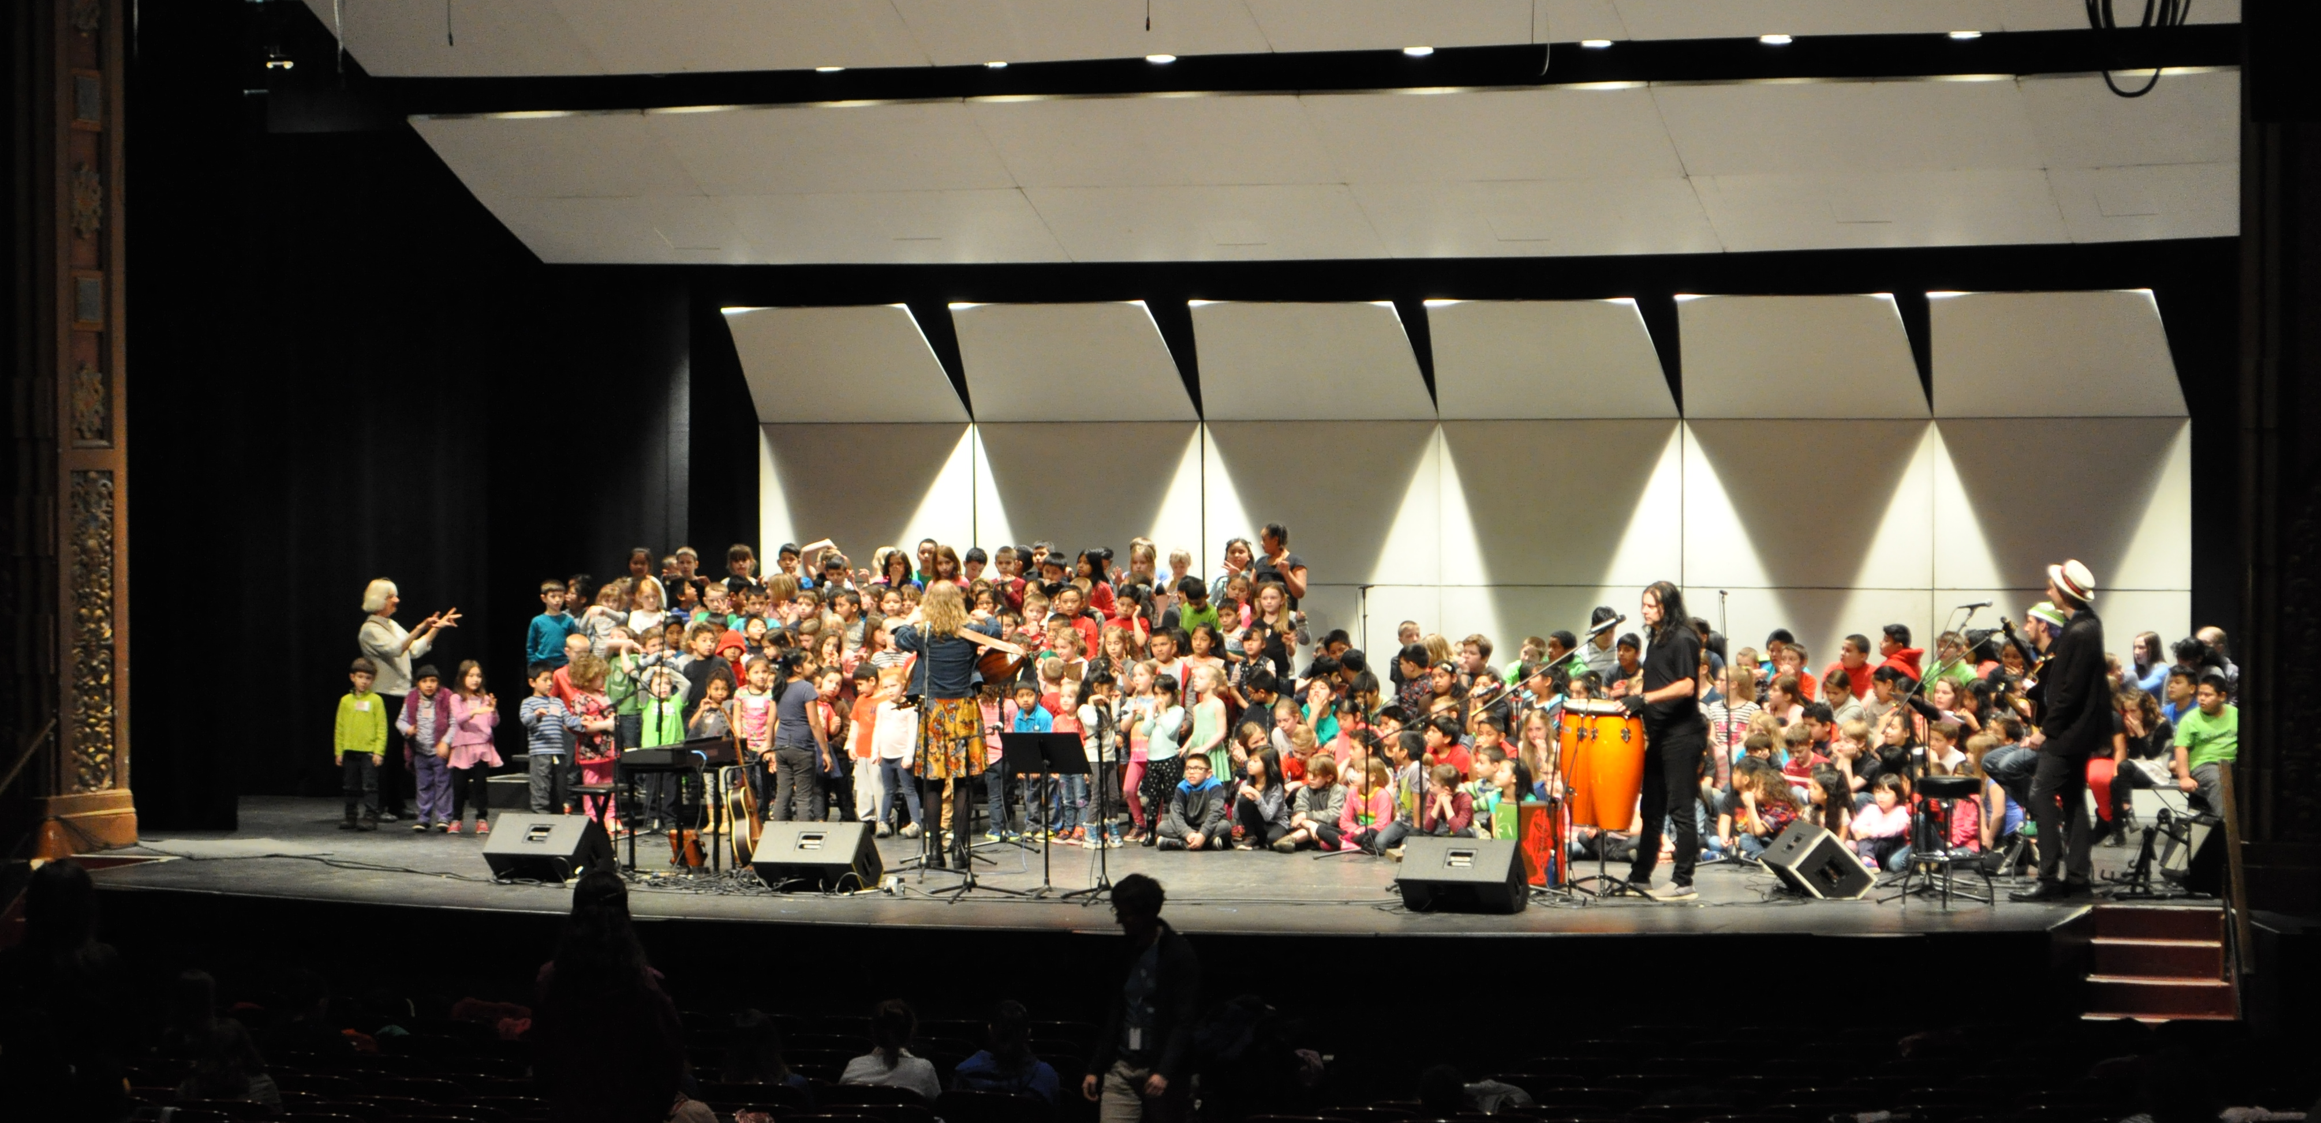
Our Shared Stewardship of Mount Baker Theatre
Through collaborative planning for long-term capital investments, we will ensure the Mount Baker Theatre's enduring legacy as a vibrant cultural hub
Notes:
Wilco. Alderwood school concert.

Slide 40
Thank You
Questions?

