Slide 1


City of Bellingham
Resource Recovery
Project Update
January 28, 2019

Slide 2
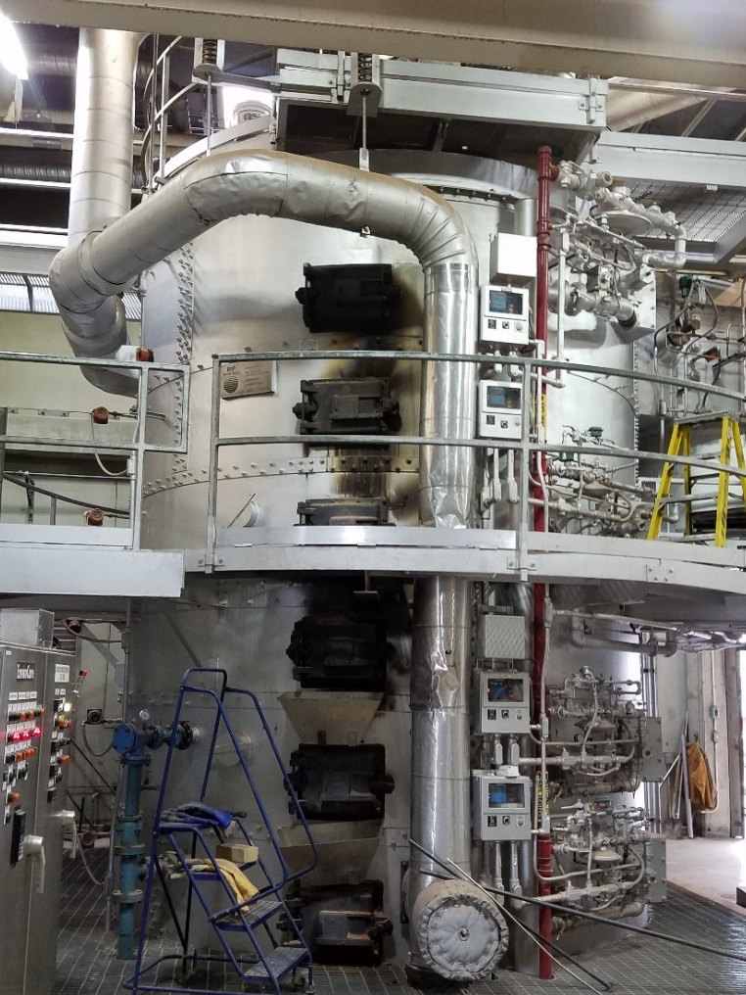
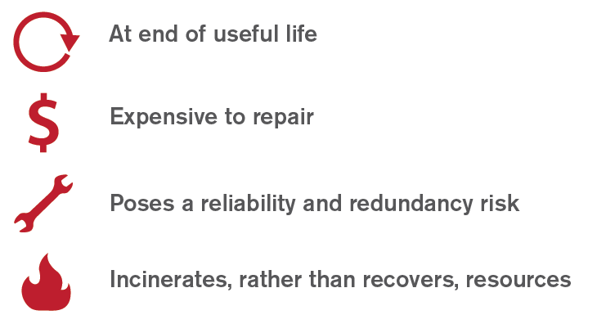
Solids Stream Project Drivers
There isn’t a “do nothing” option to address these needs.

Slide 3
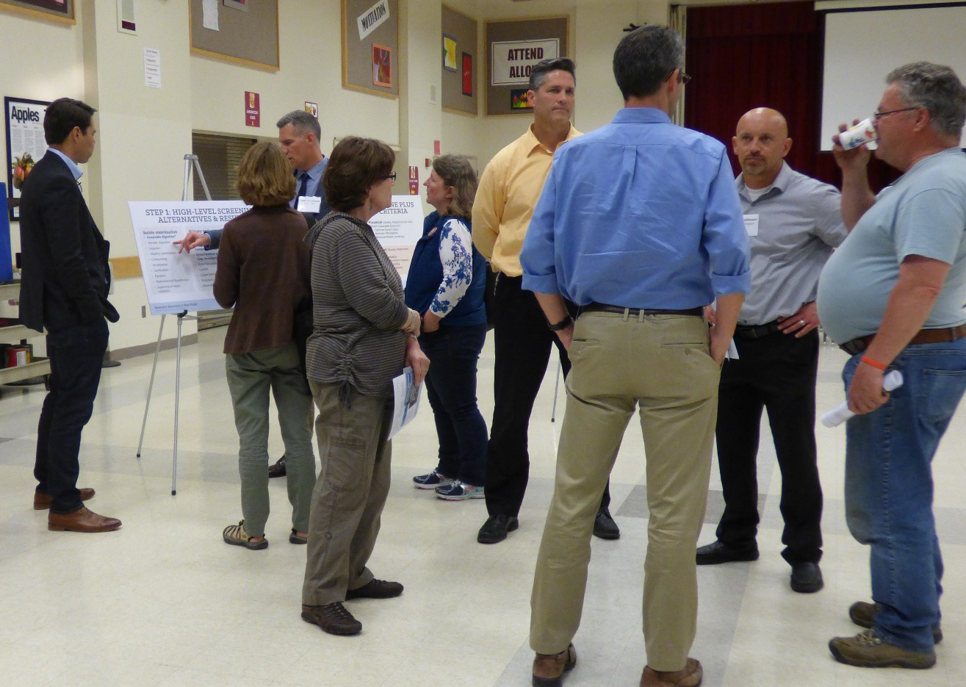
Public outreach demonstrated support for moving away from incineration
TBL+ process supported
Interest in moving to a Class A biosolids product

Slide 4
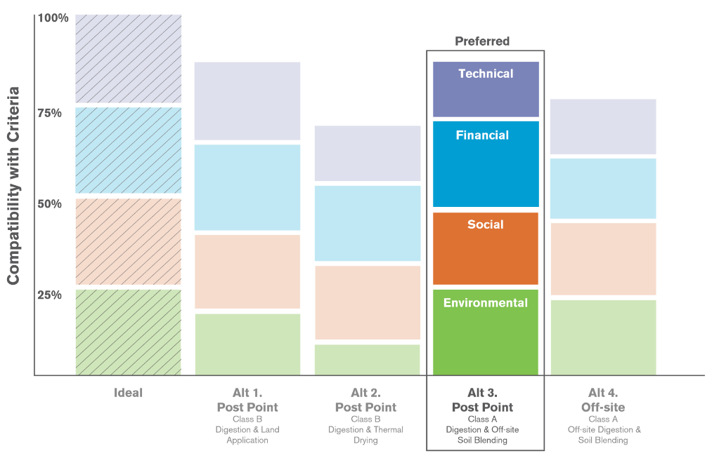
Phase 1 – Identified Class A product for local beneficial reuse

Slide 5
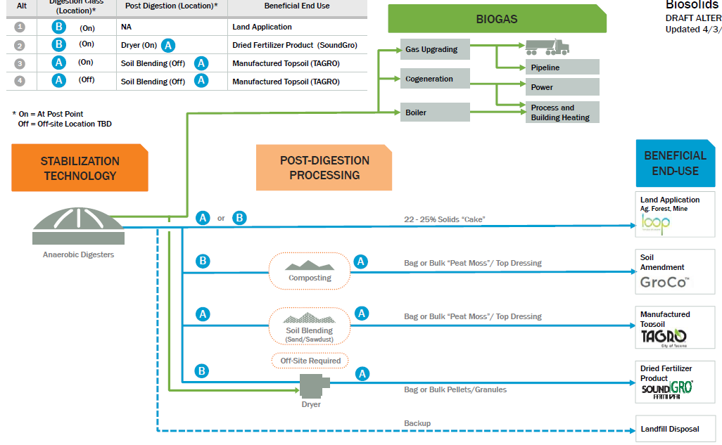
Phase 2 – Select Digestion-based approach to produce Class A and Biogas use

Slide 6
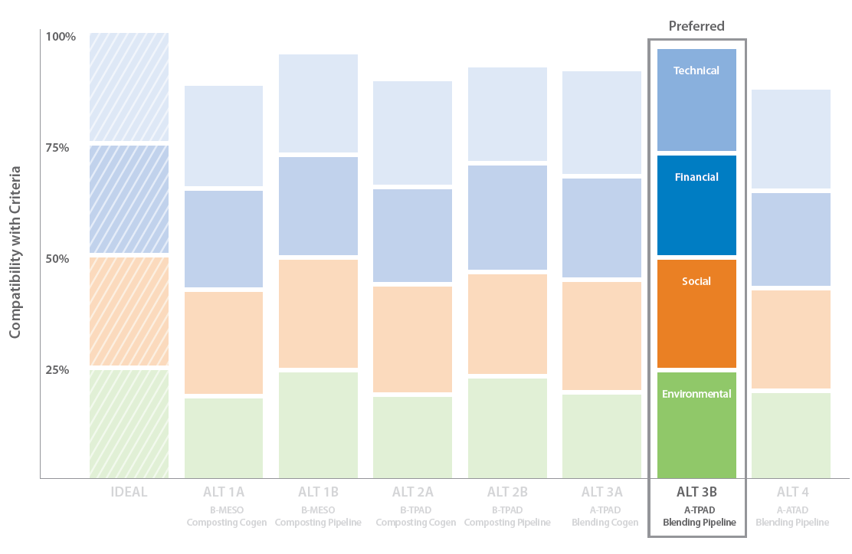
Phase 2 - Preliminary TBL+ Results: Class A Digestion and Pipeline Injection

Slide 7
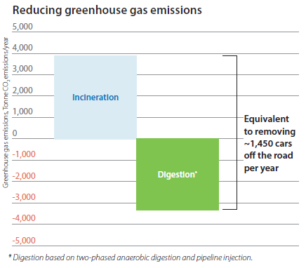
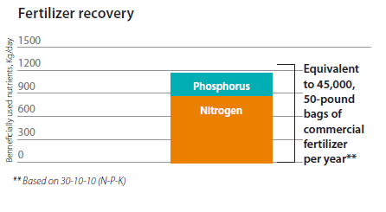
Anaerobic digestion-based solution benefits
Incineration GHG Emissions
Digestion*
GHG Savings

Slide 8
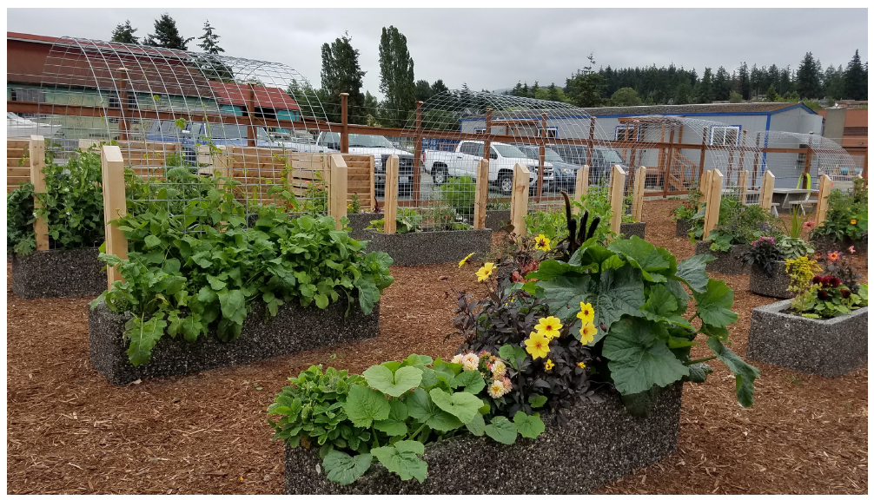
A demonstration garden at Post Point showcases biosolids at work
Provides nutrients
Improves soil health/tilth
Sequesters carbon

Slide 9
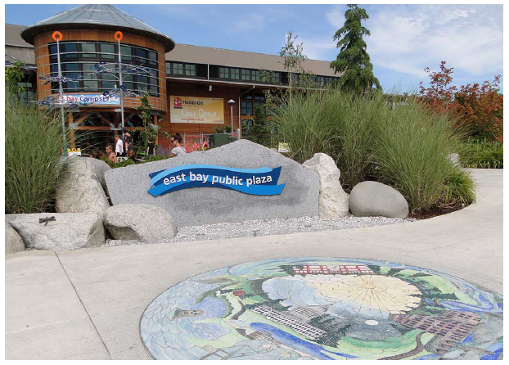
Beyond a new solids treatment system, the project includes integrating other City functions
Solids treatment
Energy recovery
Ancillary systems
Integrated Ops/ Community Building
Example of a community education and environmental outreach center (LOTT Alliance, Olympia, WA)
Notes:
Natural resources offices
Public outreach center
Maintenance building
Admin offices
Laboratory

Slide 10
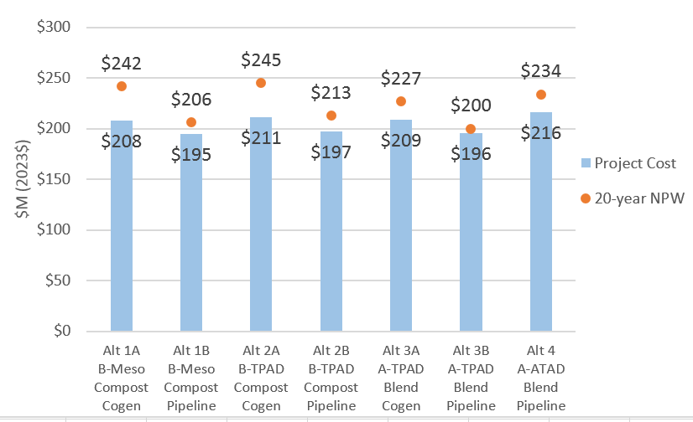
Planning Level Cost Estimate Summary

Slide 11
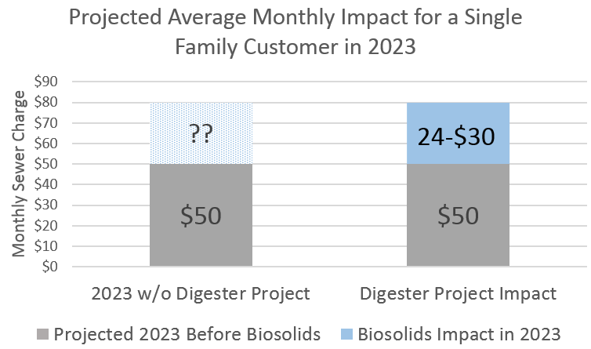
Potential Rate Impacts
$24-$30/ERU/month on average
Preliminary Analysis
Based on Equivalent Residential Unit
Rates vary across customer classes
Additional work needed for impacts to customers and affordability metric

Slide 12
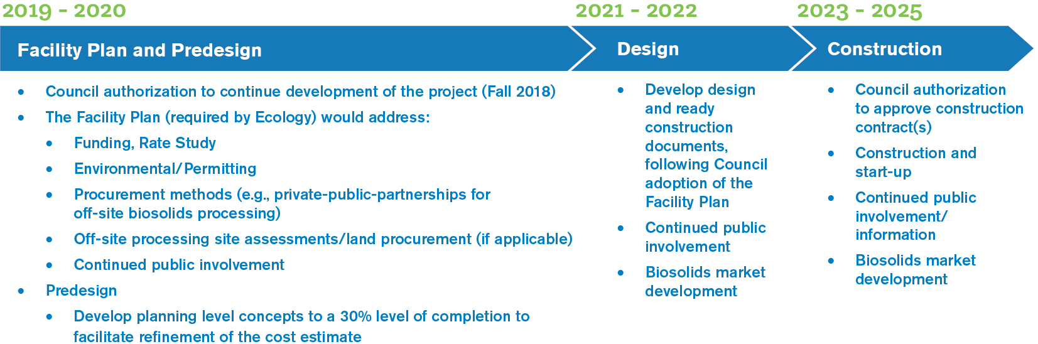
Phase 3 – Facility Plan, Procurement, and Predesign

Slide 13


Climate Action Plan
2007
2017
Notes:
Project is identified in both the 2007 and 2018 update as critical to achieving climate goals

Slide 14
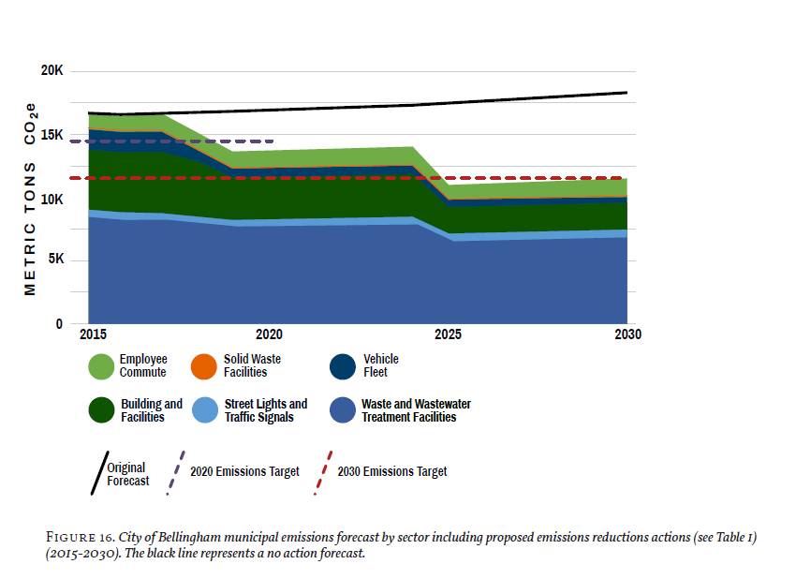
Municipal Emissions Forecast
Notes:
Project I key to meeting 2030 targets

Slide 15
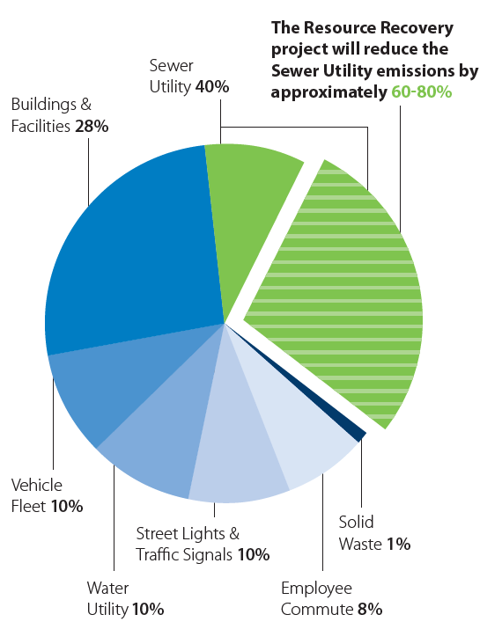

Post Point Resource Recovery
Emissions Reduction CO₂e

Slide 16
Resource Recovery Project Update
Presented by: Eric Johnston, P.E., Rob Johnson, Bellingham Public Works
Tadd Giesbrecht, P.E. Brown and Caldwell
360.778.7700 ecjohnston@cob.org, rjohnson@cob.org

