Slide 1
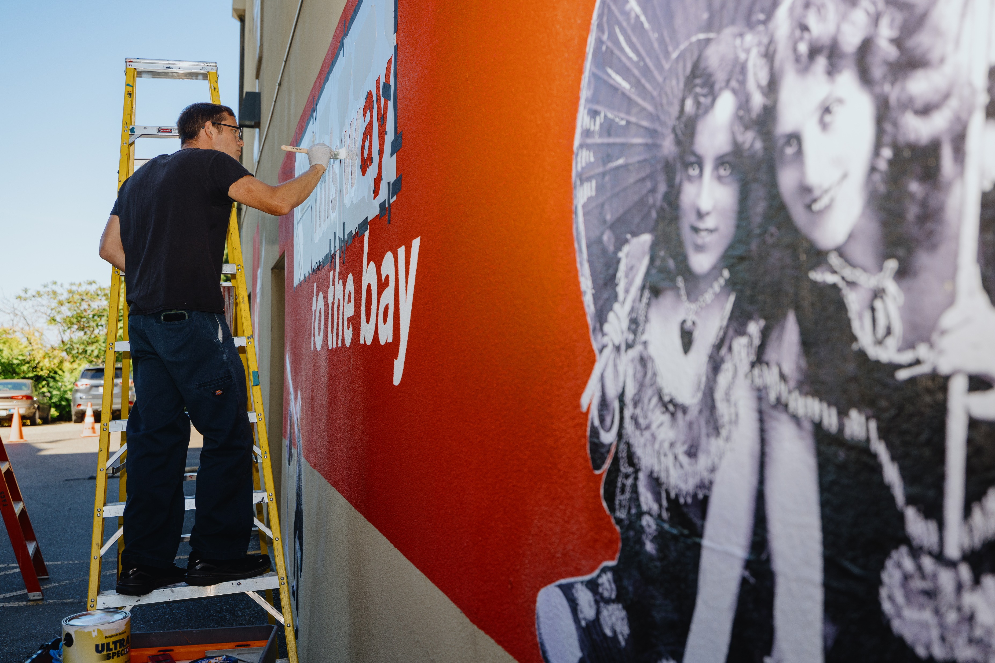
Downtown Beautification & Activation RFP
FALL 2024 LTAC RECOMMENDATIONS

Slide 2
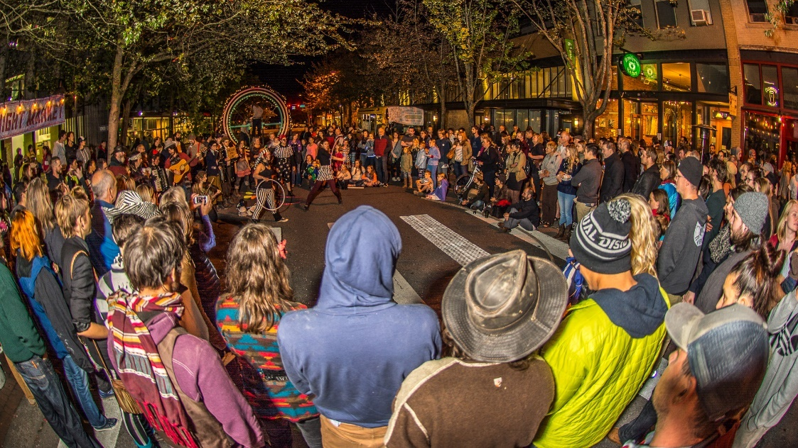
RFP Goals & Objectives
Enhance aesthetic appeal, district identity and “Instagram-worthy” opportunities.
Create a more enjoyable experience for pedestrians (“surprise and delight”) to encourage exploration, longer stays and increased foot traffic.
Activate public streets, sidewalks, plazas, and parks to promote use of underutilized spaces, foster community connections and a sense of belonging, and showcase local talent and cultural diversity.
Attract visitors and create new and memorable experiences to enhance the City’s brand as a tourism destination and boost revenue and economic growth.
Encourage connections between downtown and surrounding areas (waterfront, Old Town and residential neighborhoods).
Foster engagement of downtown stakeholders and community members to improve the experience of joy, sense of safety, and pride and neighborhood. interest in the downtown

Slide 3
Timeline and Approvals
November 15: Proposal deadline
November 20: Staff review
November 22: Jury review
November 26: LTAC review of jury recommendations
December 3: Arts Commission review of jury recommendations
December 9: City Council review of LTAC recommendations
December 10: Notify grantees and begin contracting

Slide 4
RECOMMENDED FOR LODGING TAX FUNDING

Slide 5
Coast Salish Interactive Mural
Applicant: Children of the Setting Sun Productions
Funds requested: $250,000
Funding recommended: $160,000
Location: 208 & 210 W Holly Street. Includes projection mapping, animation, and children’s art education wall.

Slide 6
Silent Film + Live Music
Applicant: Bellingham Symphony Orchestra & Pickford Film Center
Funding requested: $25,080
Funding recommended: $25,080
Location: Bay Street. 3-4 films + trivia. August 22, 2025.

Slide 7
KZAX Presents: Radio Forever
Applicant: Make.Shift Art Space
Funding requested: $38,500
Funding recommended: $50,000
Location: Adjacent alley. Live music, public artwork, educational demonstrations about radio. Community workshops leading up to event. Marketing campaign. August 20, 2025.

